Slide 1
Practical SVBRDF Capture in the Frequency Domain
Miika Aittala
Aalto University
NVIDIA Research
Tim Weyrich
University College London
Jaakko Lehtinen
Aalto University
NVIDIA Research

Slide 2
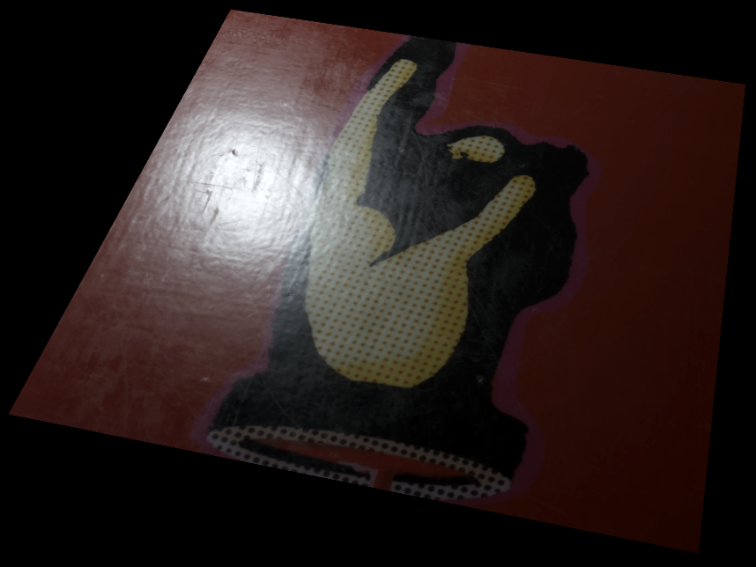
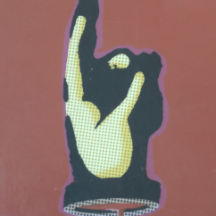
Introduction
Realistic graphics requires quality content
Geometry
Lighting
Surface materials
Manual creation difficult, expensive
We present a practical method for capturing detailed spatially varying surface appearance
Notes:
Thank you for the introduction.
Realistic computer graphics requires not only advanced rendering methods, but also high quality content.
Producing content by hand is difficult and expensive, so it would be desirable to capture it directly from the real world.
We present a method that captures materials accurately using a simple physical setup.

Slide 3
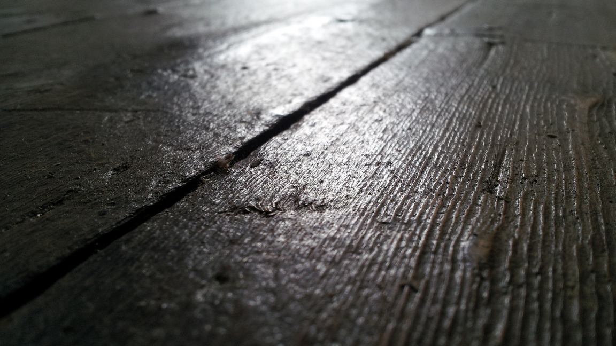
Flickr user Jacob Whittaker (CC)
Notes:
Real-world surface materials exhibit rich spatial variation, as can be seen in these photos.
The precise reflectance model itself is often secondary; it is the spatial variation that gives these surfaces their character.
http://www.flickr.com/photos/45097561@N00/7521440592/in/photolist-csDmfd-gKMfF-3P95a-XYumy-KzJuj-6QRYm4-7qANW6-5jfMa2-9hrWL4-etf1p-6rF7R-4vFTnU-5PcVGd-5PcVf1-5PcVxS-5PcVpL-92exyf-78qgR7-5X3tMB-7zsDNn-3cvzXt-oS9Wf-7up2f-9SwcwX-4mrs4m-95WRQr-4pvsKp-59chzg-83NKB9-6arsus-5rhVmY-7WJL18-ajfKED-83KmQg-83Kq22-4mJvAu-83Koir-6treoT-GfwTZ-dooLWt-4rfB1L-4Wqsc7-4Wmc94-3aUMpr-3aUMqn-mCoLj-huoJZ-5CvXKv-4S2KCB-3MMaP-3MLdi

Slide 4
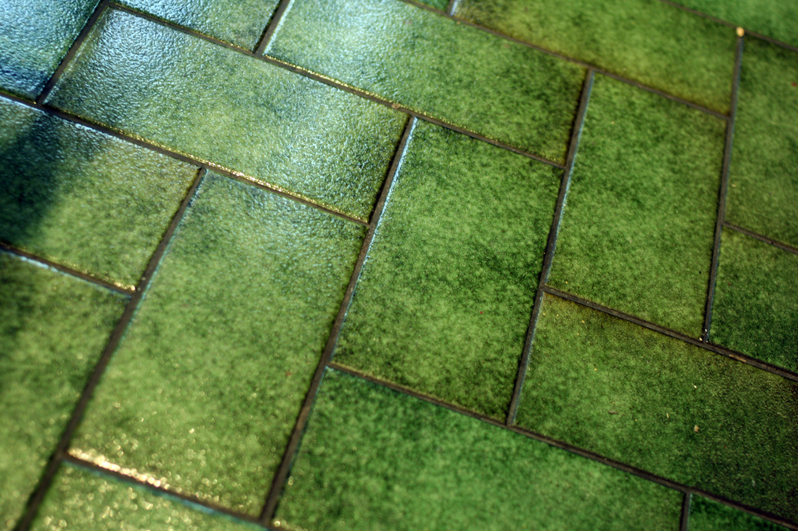
Flickr user Serenae (CC)
Notes:
http://www.flickr.com/photos/serenae/6804163629/

Slide 5
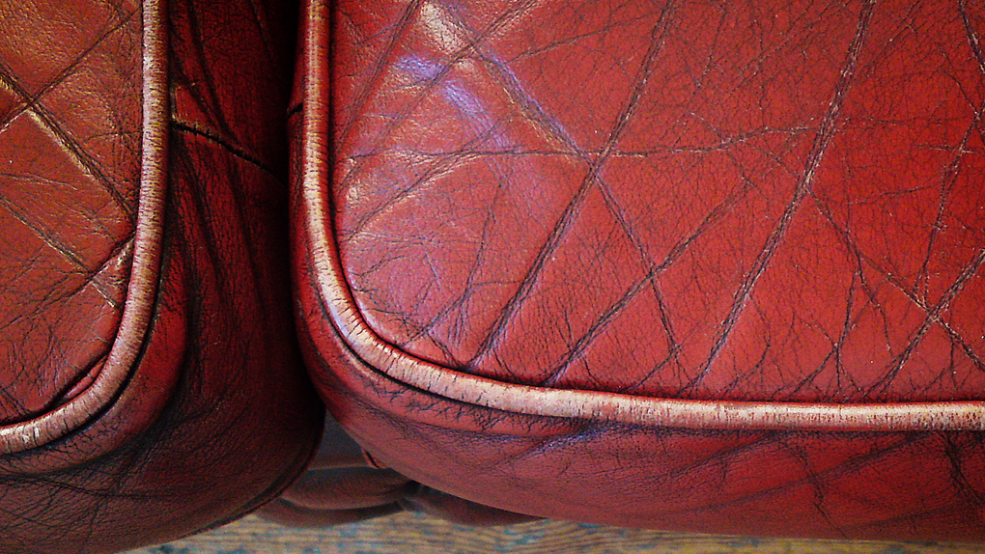
Flickr user this is markb (CC)
Notes:
http://www.flickr.com/photos/84848927@N00/4525959656/in/photolist-7TWJ8b-39xW7S-4r9za1-b97Zzi-b981ek-b981KM-7eEgVd-4n2z3o-5vG8or-7uHuLi-7uMkSS-7uMkPb-xdhLb-5vJzdS-kz9hV-aAwtja-kztsr-7MY2D1-6m2ip-9TETGZ-8cZV1t-csExqN-pfYDy-4n5Ayy-dhoHp6-bx7Eot-8UNtNB-e75WB4-b1ro48-5kkD8V-f8xap-zn4jV

Slide 6
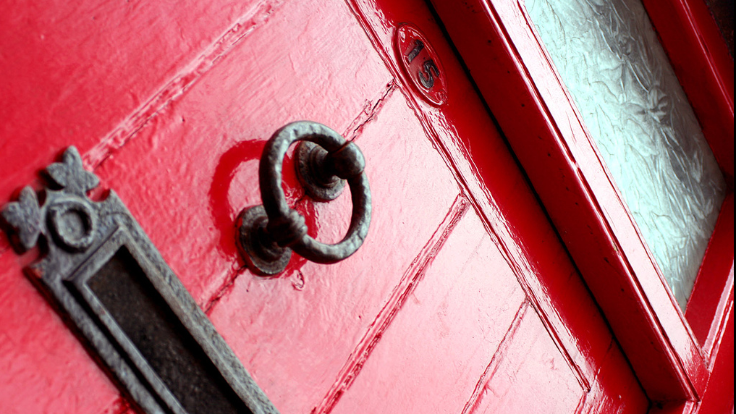
Flickr user hungryblank (CC)
Notes:
http://www.flickr.com/photos/hungryblank/129549674/

Slide 7
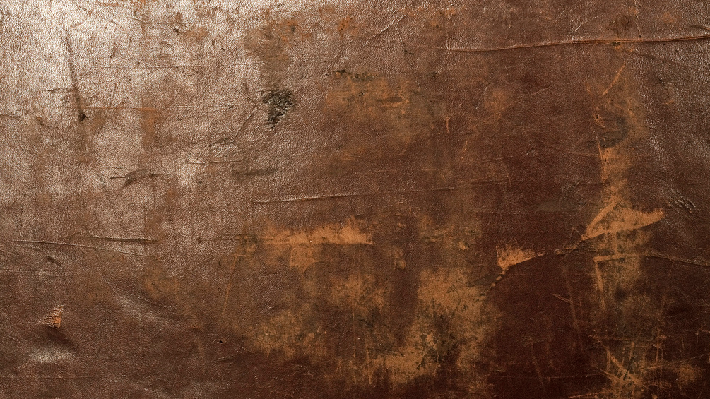
Flickr user agatauw (CC)
Notes:
http://www.flickr.com/photos/21020954@N06/4262195595/in/photolist-7uCSfX-cD9iNY-8xpeey-4td4TQ-4d7efo-Bsoqj-66h41t-5KSust-59LAmz-5ppj8R-6sy5kg-8Vs5pY-4eEAXt-79h39G-axB4y8-3E2D8-DPS7q-82q9bq-6bn41J-ajEnoE-4DMtmp-8zc39f-8z8W7a-8zc2hY-8z8Smt-8z8Vfg-c3YaDo-Bc8TF-4XqF8N-bWabxz-6V7kkF-4ZEini-5jizsS-edjGAi-bAfDnd-gX8a3-bD3Ga2-7TPHP3-4kaczb-Cjpmb-ev9eDH-9gPY8D-5XciYt-292WDQ-uiFmp-7vEw18-6gPzkr-6gTHNA-8s2aGw-ENk9g-7Jnyv6

Slide 8
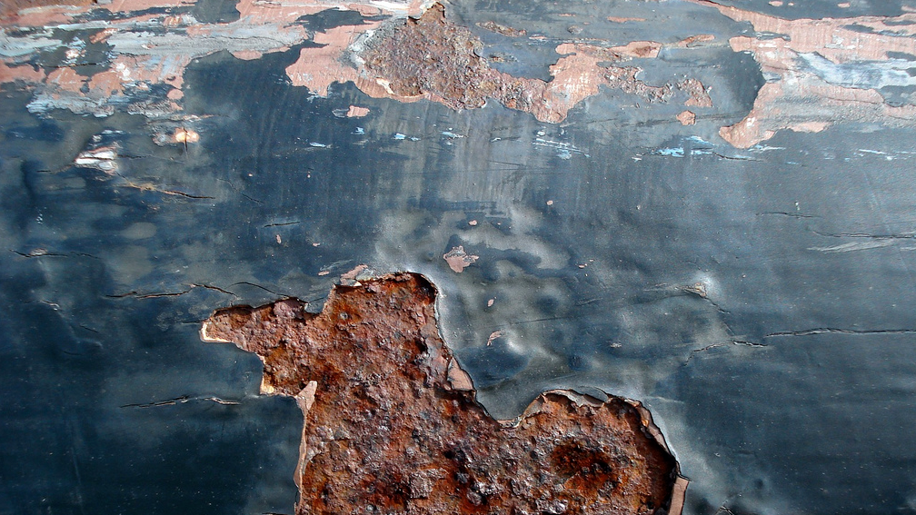
Flickr user Mykl Roventine (CC)
Notes:
http://www.flickr.com/photos/64419960@N00/2011052257/in/photolist-44HaLM-65QZ6E-6EGQXT-areaX-byNtRa-4TBcXT-2uE3t-2fv4u6-2bbwi-5F4DpJ-Ekuiv-7zUJNY-dA5Ap-9e1TU5-6cBMWN-6e82i6-5gcSh-a5hSa-xsrJj-ny2v7-Dm7ow-8syYVv-7Sc2Vy-8yd73C-nDDA7-3dfZrY-wSER4-5PUQcQ-6UJK3e-7MKp-Etuqx-8HuNZf-4kuQr-fwXjQ-MreDS-8s941G-vm3QB-xst1i-8wnisY-4qyyM5-4FqjxS-4CaNp7-Hty5Q-4C6uwV-7MABf1-6tpogW-9hNGQR-6EMbSj-6m8xoC-6fBL4i-3p3sTF

Slide 9
Goals
Capture rich spatial reflectance variation
Using standard office hardware only
Output directly usable by modern renderers
Notes:
Based on these considerations, our goal is to capture the detailed spatial variation of a parametric BRDF model.
We achieve this using only standard office hardware, and produce output texture maps that are directly usable by modern renderers – in particular, real time rendering.

Slide 10
Related work
Notes:
Let us look at some previous work.

Slide 11
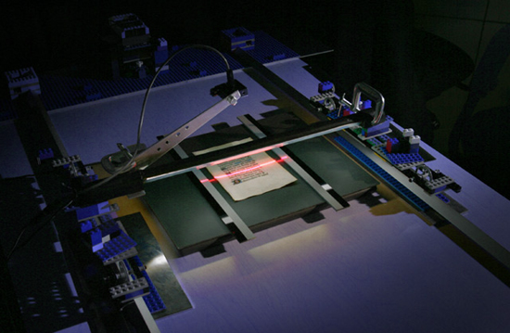
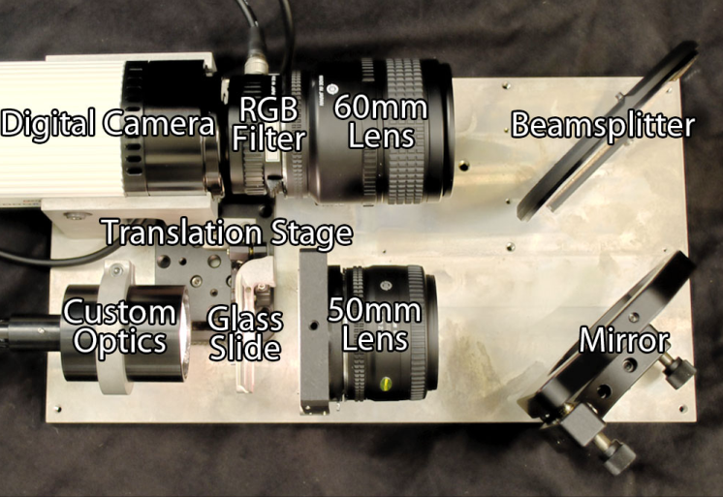
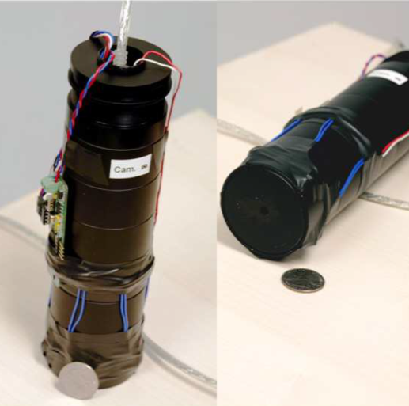
Custom equipment
Gardner et al. (2003)
Holroyd et al. (2010)
Dong et al. (2010)
Notes:
Pretty much all capturing methods are based on emitting light and observing how it interacts with the surface.
Many of the successful previous methods are based on custom hardware.

Slide 12
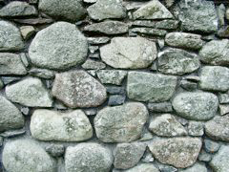
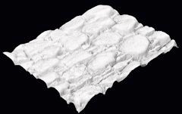
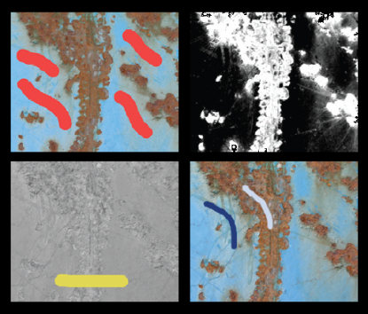
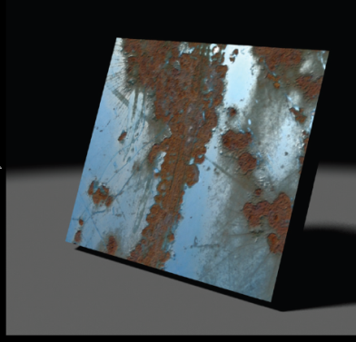
Strong priors and heuristics
CrazyBump
Proprietary heuristics
”Dark is deep”
E.g. Glencross et al. (2008)
Intrinsic images, user guidance
AppGen (Dong et al., 2011)
Notes:
On the other hand, light-weight methods often produce impressive results, but do not necessarily reproduce the true appearance faithfully.

Slide 13
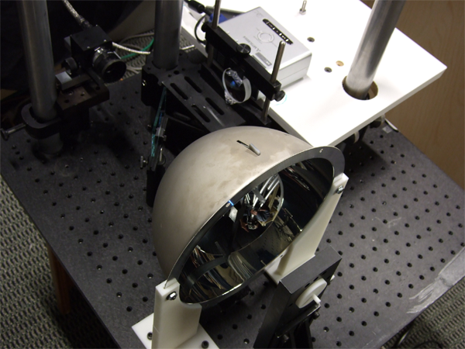
Basis illumination
For BRDF measurement
Sato et al. (2003), Ghosh et al. (2007)
For SVBRDF
Low-order spherical harmonics (Ghosh et al. 2009, 2010)
Notes:
Other work uses continuous illumination for aliasing-free acquisition of BRDFs and SVBRDFs. Our system system extends these approaches.

Slide 14
Our approach

Slide 15
Design goals
Capture materials that can be represented as diffuse + specular + normals
No custom hardware
No moving parts
No user intervention
Notes:
Our premises are as follows. We assume that the material follows a simple diffuse-specular-normals model.
Our goal is to build a system that requires no custom hardware, moving parts or user intervention during the capture.

Slide 16
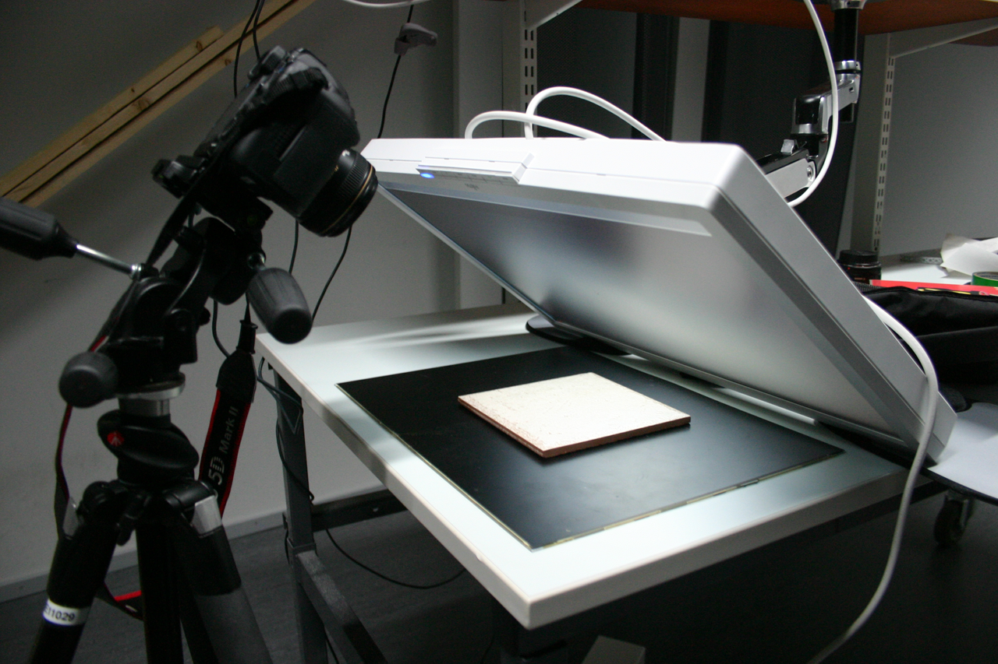
Monitor as a programmable area light source
SLR camera
Approximately flat material sample
Notes:
We use a system shown in this photo.
The flat material sample is placed underneath a tilted LCD monitor.
The monitor displays patterns and the camera records their reflections.

Slide 17
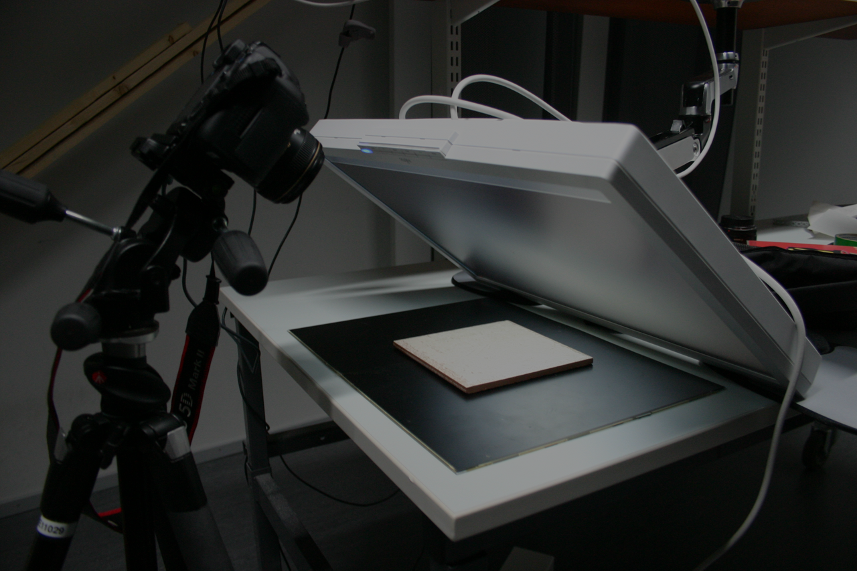
Near field illumination, fixed camera
Notes:
Placing the monitor very close to the sample allows us to observe reflections from a wide range of angles.
However, our method must now explicitly consider the near field illumination effects.
We also observe only a single camera angle. To generalize to novel views, we fit a parametric model to the observed reflection slice.

Slide 18
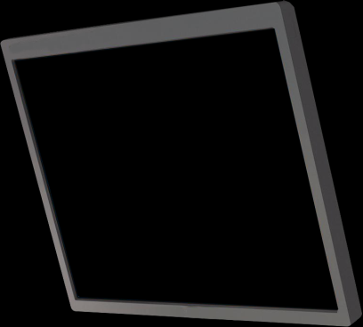
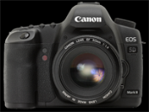
Image formation
=
Light rays leave the emitter and find the camera
Importance rays leave the camera and find the emitter
Notes:
Let’s have a look at what happens when we take these pictures.
First of all, instead of propagating light, we propagate importance from the camera – as is often done in for example ray tracing.

Slide 19
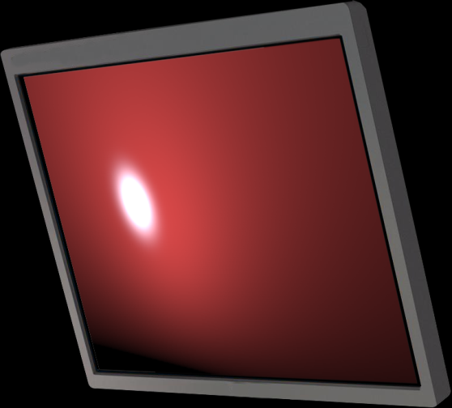
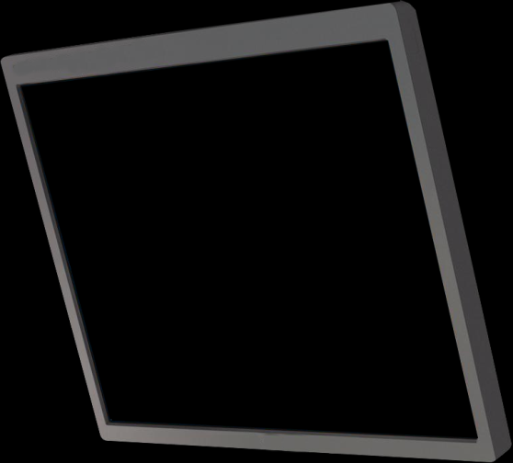
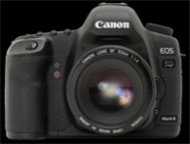
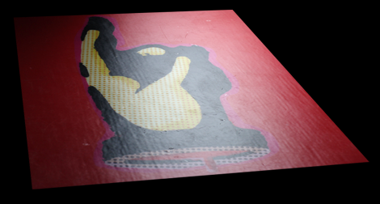
Reflection and measurement
BRDF slice
emission
Specular
=
Encodes the effect of surface color, glossiness, normals, etc.!
However, cannot be seen directly.
Diffuse
=
BRDF

Slide 20
High-level plan
Physical measurement
Emit patterns, take pictures
Parametric model
Mimic measurement process computationally
Optimization
Recover parameters by fitting model to measurements
Notes:
4:00
Our approach is a classical measure-and-fit one.
We obtain physical measurements of the reflectance by emitting patterns from the monitor.
We then fit a parametric model using optimization, to obtain the albedos, glossiness and normals for every surface point.

Slide 21
Generic approach
Per-point, nonlinear optimization
Model evaluation in every iteration
General case needs numerical integration
Prohibitively expensive
BRDF slice
emission
=
=
Notes:
The general approach is to solve a per-point non-linear optimization problem, which requires iterative methods that evaluate the BRDF integral in the inner loop. In our setting, this can lead to hundreds of millions of evaluations.
Arbitrary emission patterns and a general BRDF model, however, can only be integrated numerically, which would lead to trillions (or quadrillions) of BRDF evaluations and hence be computationally intractable.
// 512^2 px * 130 patterns * ~8 iters * 5 fd-taps

Slide 22
Our approach
Joint design of
emission patterns
reflectance model
analytic image formation model
Analytic integration
BRDF slice
emission
?
=
?
=
Notes:
To drastically reduce the costs of integration, we jointly design our emission patterns and the computational image formation model.
In effect, the integral can be evaluated with a simple analytic formula. PAUSE.

Slide 23
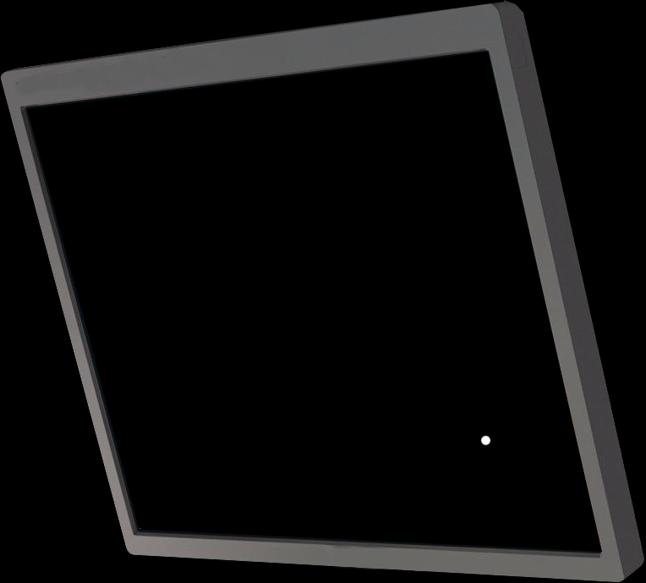
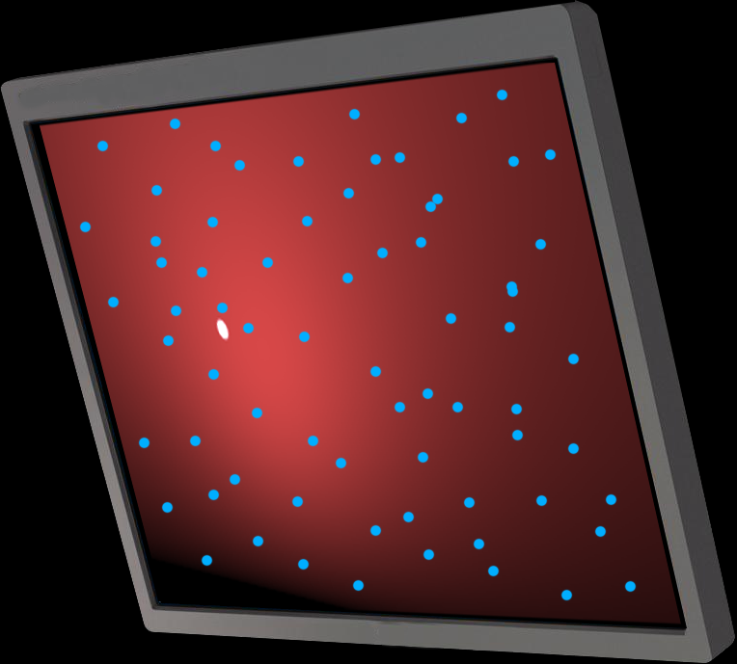
Alternatives
Point evaluations
Aliasing, missed speculars
Dynamic range
Spherical harmonics
Require distant spherical illumination
Notes:
One simple way to allow for quick reflectance integration would be to use point-shaped illumination.
This approach runs into trouble with sharp speculars, in the form of aliasing and exposure problems.
Other ideas involve for example spherical harmonics. However, they are not suited for our setup because they require distant full spherical illumination.

Slide 24
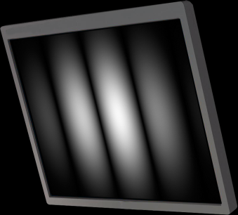
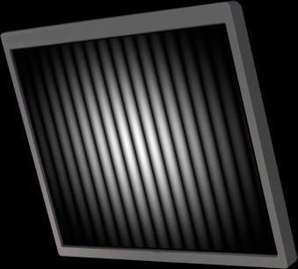
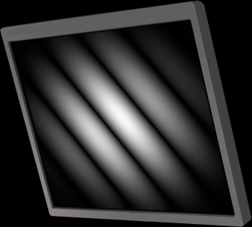
Our choice: windowed Fourier basis
Well-behaved with extreme gloss
Albedos, normals and glossiness have simple effects on data
Useful analytic properties
Notes:
Our choice is to display windowed Fourier basis functions, which are essentially waves at different frequencies and orientations as seen here.
As continuous patterns, they support almost mirror-like materials. As we will see, the reflectance parameters have a clear effect on the data, and furthermore, allow for efficient analytic integration.

Slide 25
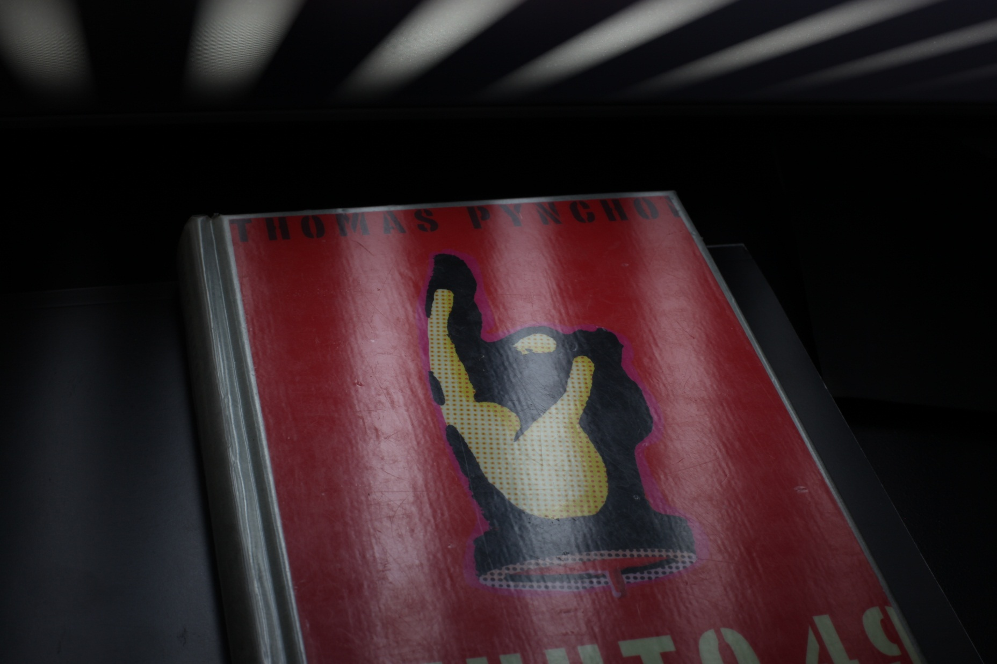

Slide 26
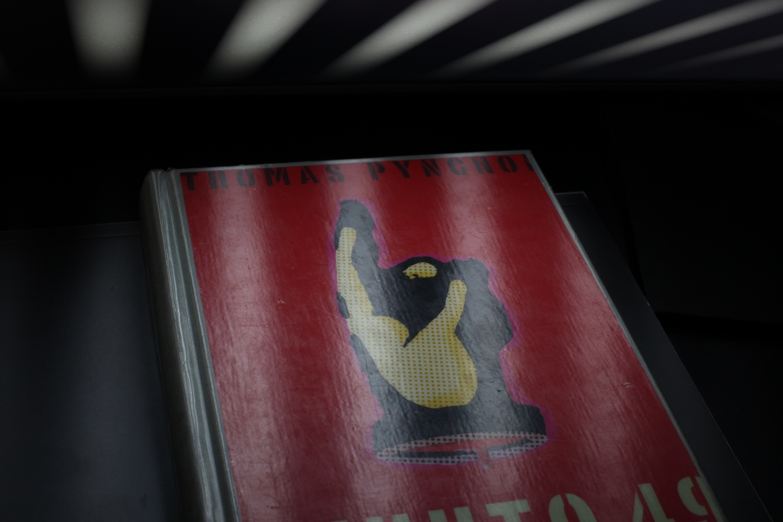

Slide 27
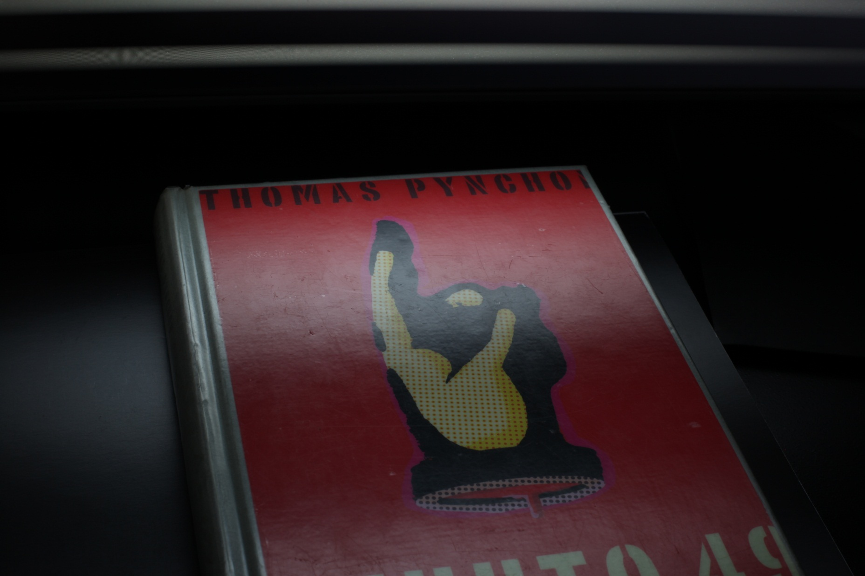

Slide 28
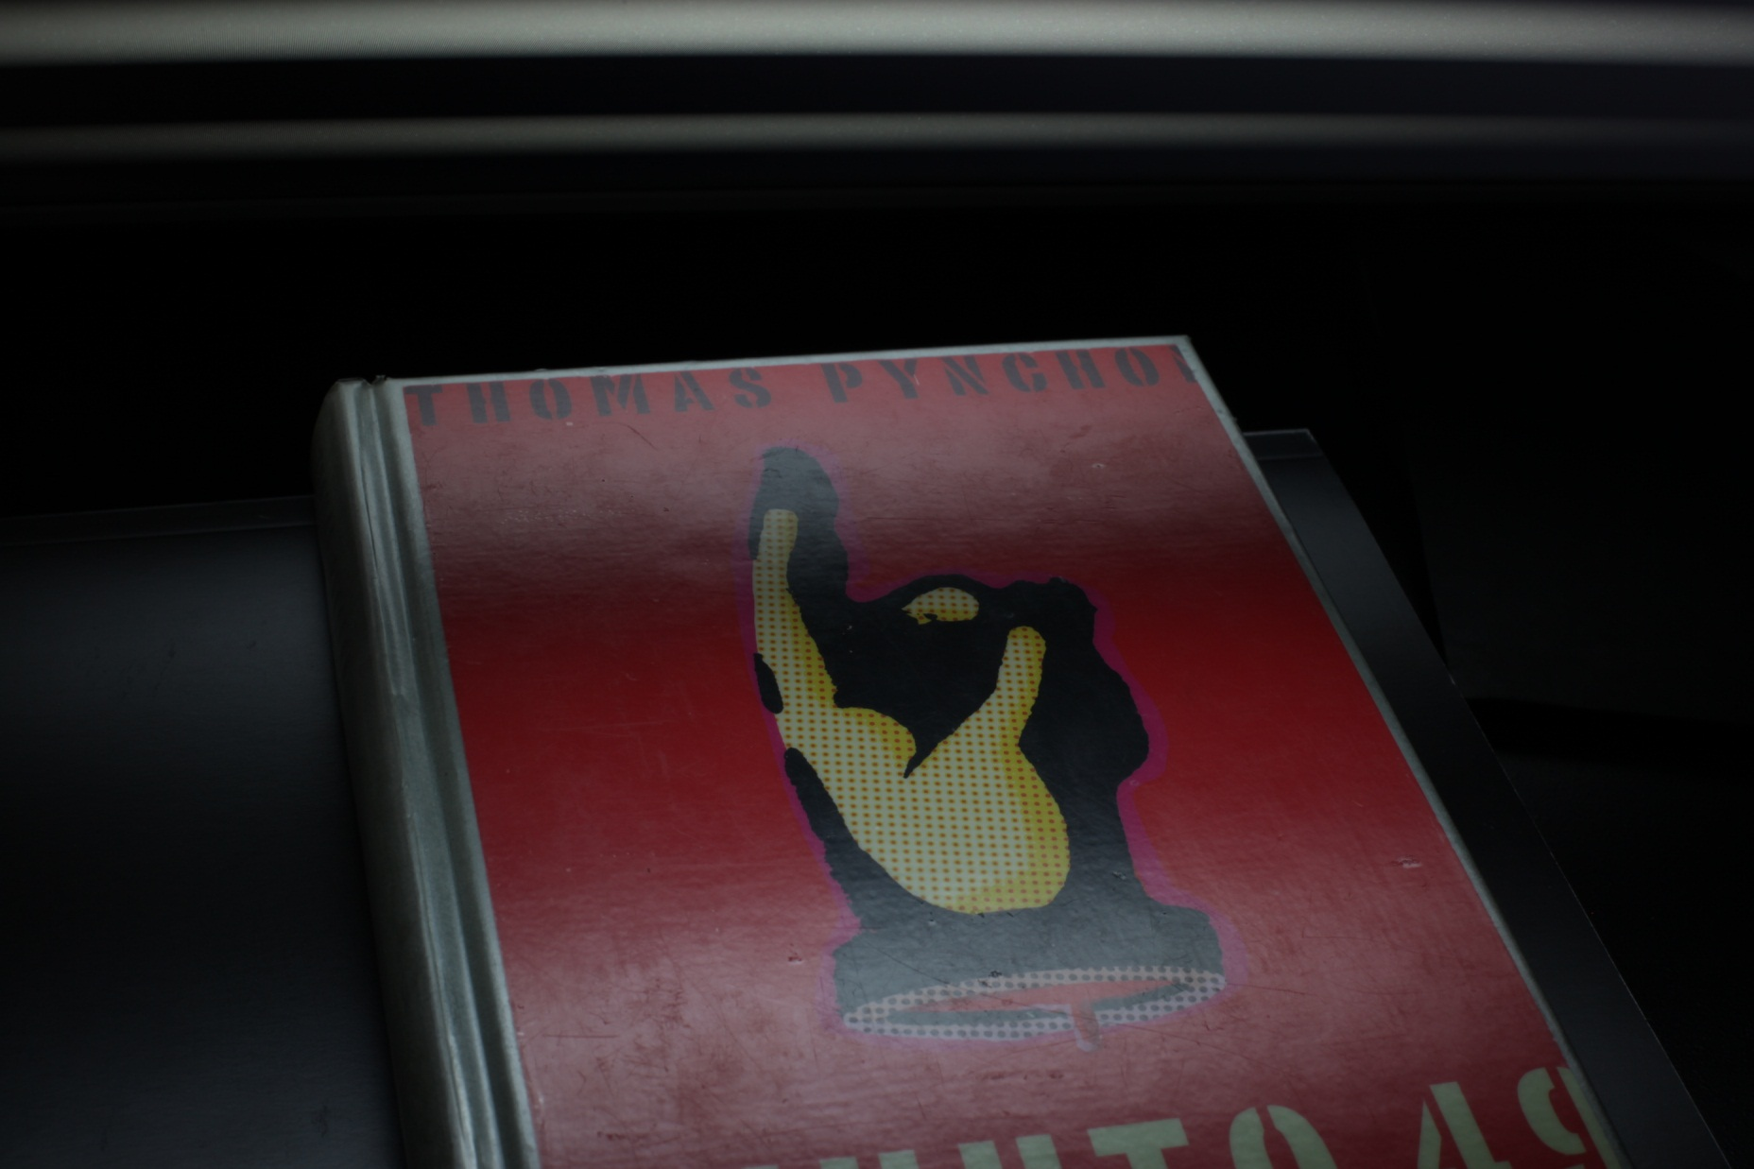

Slide 29
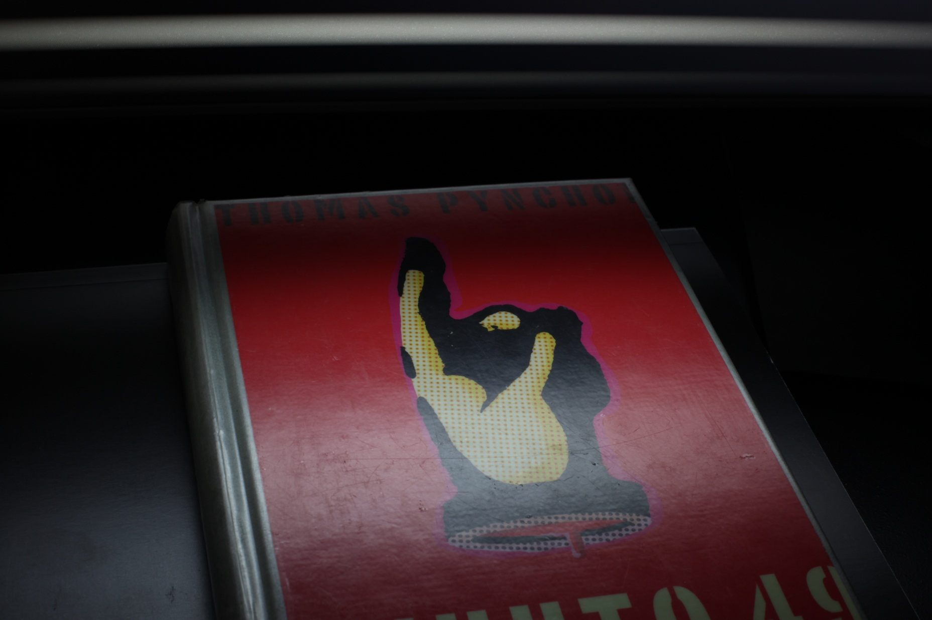

Slide 30
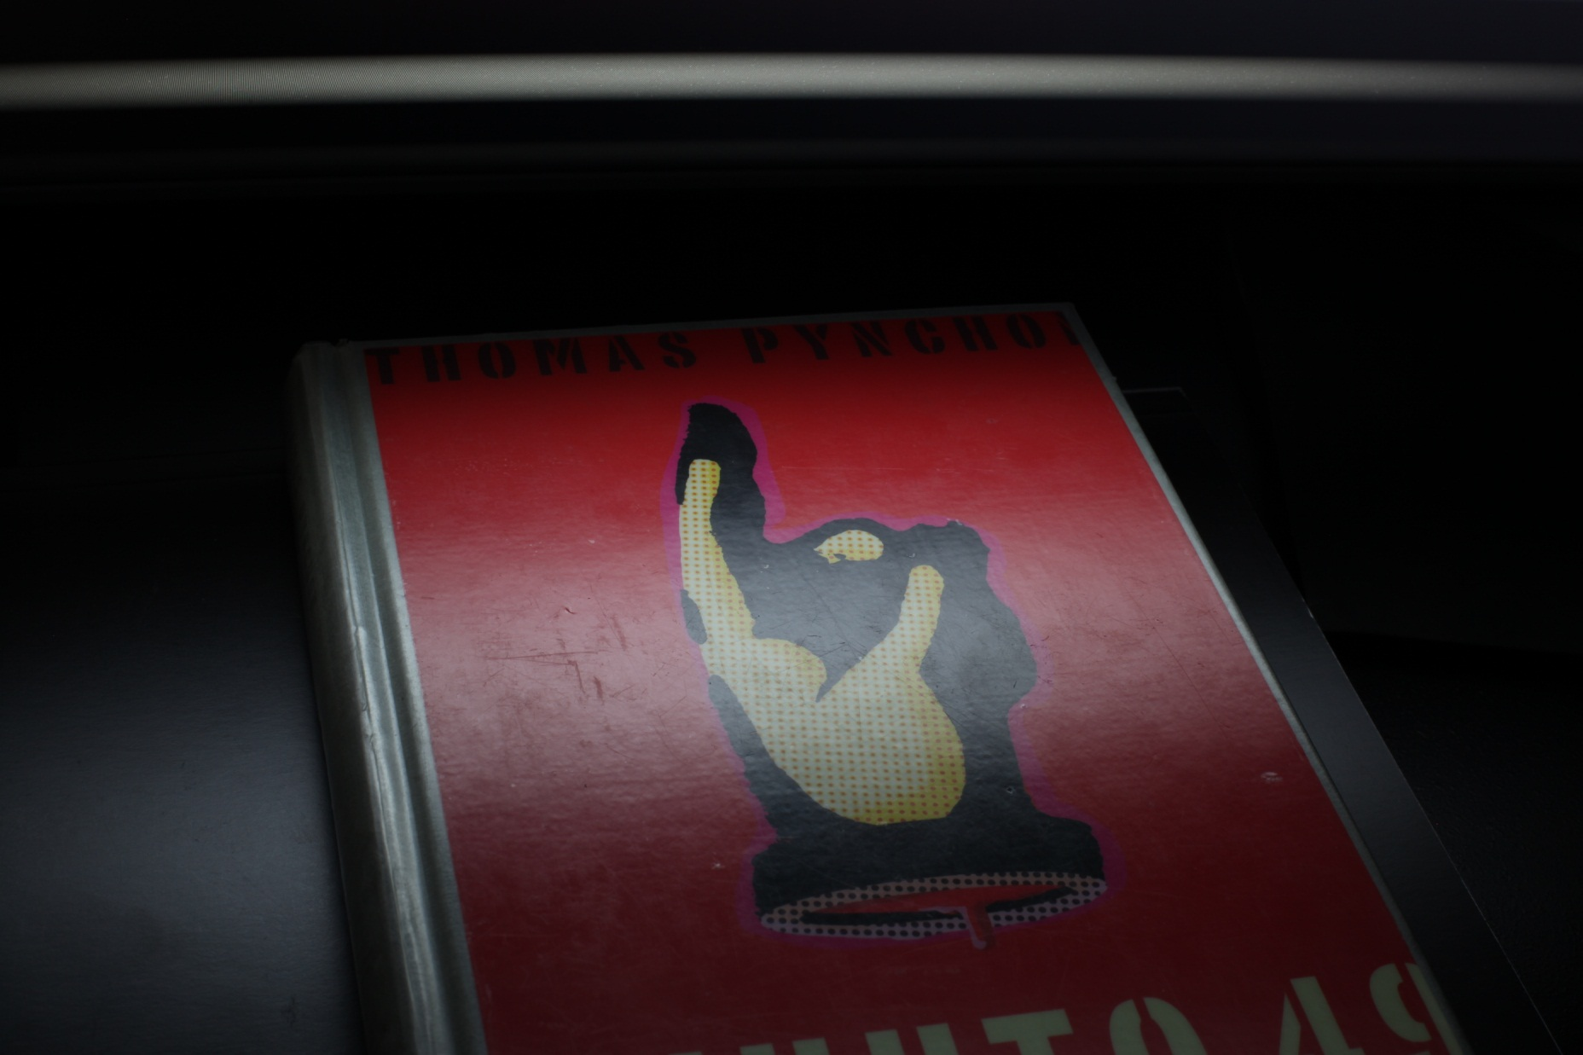

Slide 31
Note
Remainder of the slides concerns BRDF at a single surface point
Applies to all points separately

Slide 32
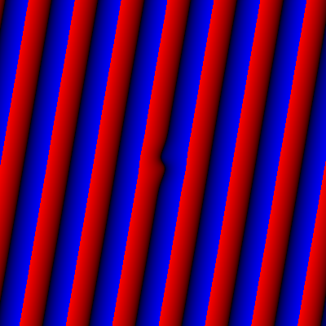
Measurements are point samples of BRDF spectrum
BRDF slice
exp ( -iω^{T}x )
16 horizontal cycles
4 horizontal cycles
4 diagonal cycles
magnitude
phase
=
y-frequency
ω = (16,0)
ω = (4,0)
ω = (4,4)
x-frequency

Slide 33
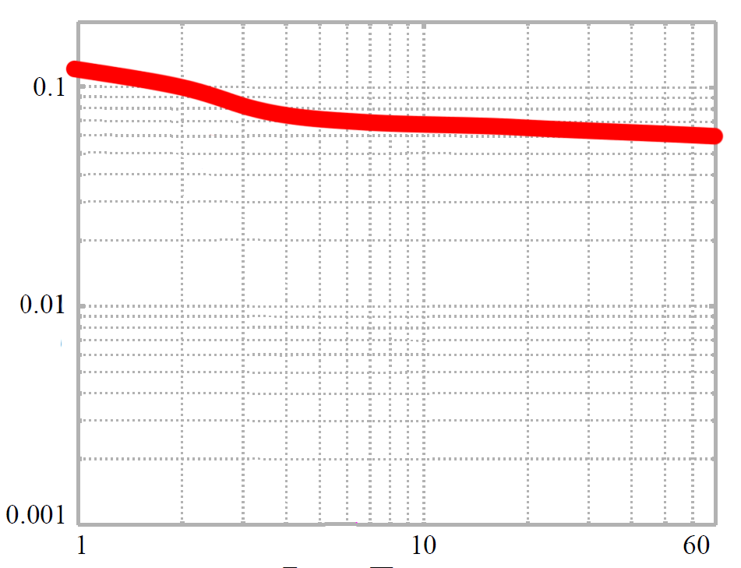
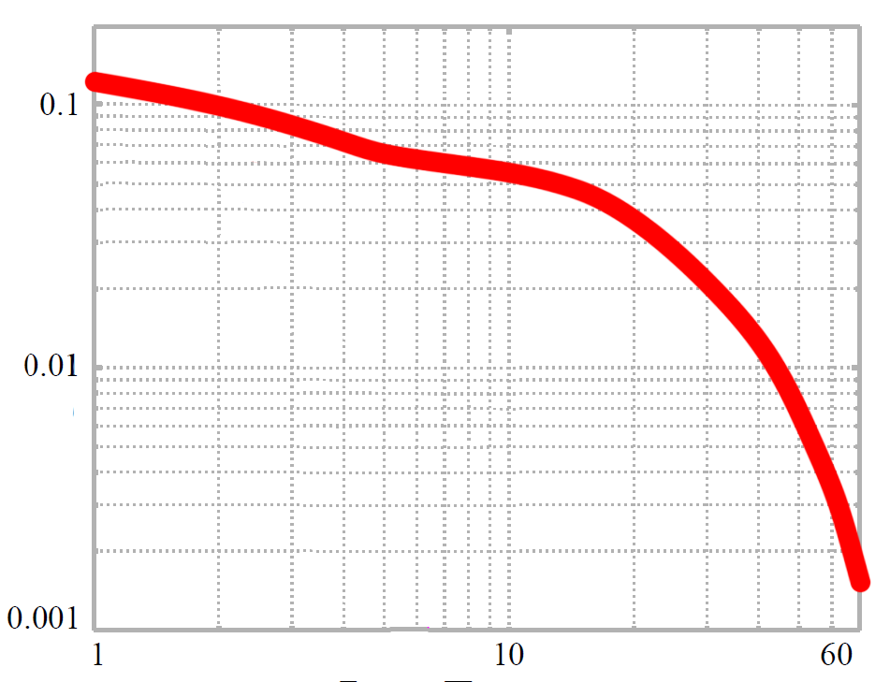
=
phase ~ normals
Consider a very glossy BRDF
extrapolation
=> suffices to observe low frequencies
Diffuse component is low frequency (bump)
Specular peak has power in high frequencies too
Log magnitude
height ~ albedos
Significant power remains at highest measured frequencies
decay rate ~ glossiness
Log frequency

Slide 34
Data fitting
BRDF slice
Input: measured point samples of
Unknowns: parameters that generate (albedos, glossiness, normals)
Need to predict from parameters
Notes:
(NOTE when editing/reviewing: notice the fading-out black bars)
8:45

Slide 35
Efficient Fourier transform
Idea: build BRDF slice as mixtures of 2D Gaussians in monitor plane
Gaussians have an analytic Fourier transform
BRDF slice
albedos, glossiness, normals
Built using Gaussians!
Notes:
Our key insight is that by expressing the BRDF slice as a mixture of Gaussians in the monitor coordinates, we can analytically Fourier transform it, avoiding the expensive numerical integration discussed earlier.
This is because Gaussians have an effective analytic transformation formula.
Our agenda then, for the next few slices, is to construct a model that takes in the unknown parameters, and outputs a mixture of Gaussians that approximates the BRDF slice.

Slide 36
=
+
BRDF slice
Diffuse
Specular

Slide 37
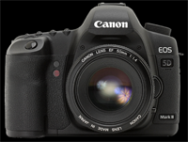
=
+
Reflection
Diffuse
Specular
Depends on
Known parameters (calibrated)
Camera and monitor position
Surface point
Unknown parameters
Specular albedo
Glossiness
Kurtosis
Normal

Slide 38
=
+
Reflection
Diffuse
Specular
Depends on
Known parameters (calibrated)
Camera and monitor position
Surface point
Unknown parameters
Specular albedo
Glossiness
Normal

Slide 39
=
+
Reflection
Diffuse
Specular
Careful Gaussian approximation of Blinn model
Accounts for translation, scaling and stretching due to near field effects
Gaussian

Slide 40
=
+
Done!
Reflection
Diffuse
Specular
Product of geometric terms
Inverse square distance
Cosine of angle to screen
Cosine of angle to surface

Slide 41
=
+
Done!
Reflection
Diffuse
Specular
=
=
1/D²
cos(screen)
cos(normal)
Affine
1/D⁴
=
(
)
*
+
+
Affine
Mixture of Gaussians approximation to 1/D⁴

Slide 42
Complete model
(
)
=
+
BRDF slice
Diffuse
Specular
*
*
Window
Monitor angular emission
distribution

Slide 43
=
BRDF slice
[
(
)
*
+
+
Affine
Gaussian
Gaussian
Gaussian
Affine
MoG approximation to 1/D⁴
]
*
*
+
Gaussian
Gaussian
Gaussian
Specular
Window
Monitor
emission

Slide 44
Optimization
Levenberg-Marquardt, finite differences
Objective = data fit error + priors
Multiresolution scheme
32 x 32 => 64 x 64 => … => 1024 x 1024
Data-dependent upsampling scheme
Data-dependent priors

Slide 45
Results
Notes:
13:00

Slide 46
(video)
see project webpage at
https://mediatech.aalto.fi/publications/graphics/FourierSVBRDF/

Slide 47
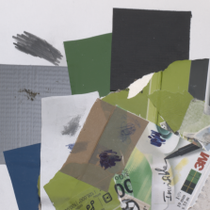
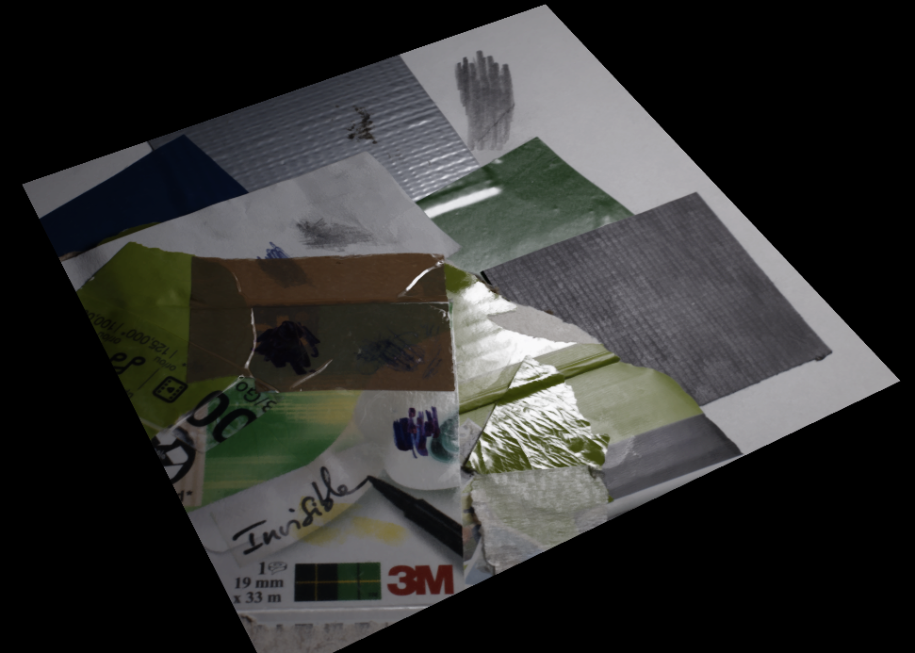
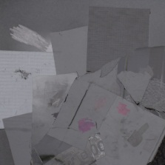
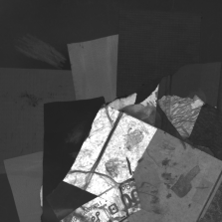
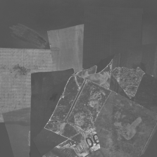
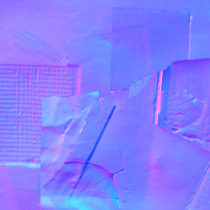
Diffuse albedo
Specular albedo
Glossiness
Kurtosis
Normals

Slide 48
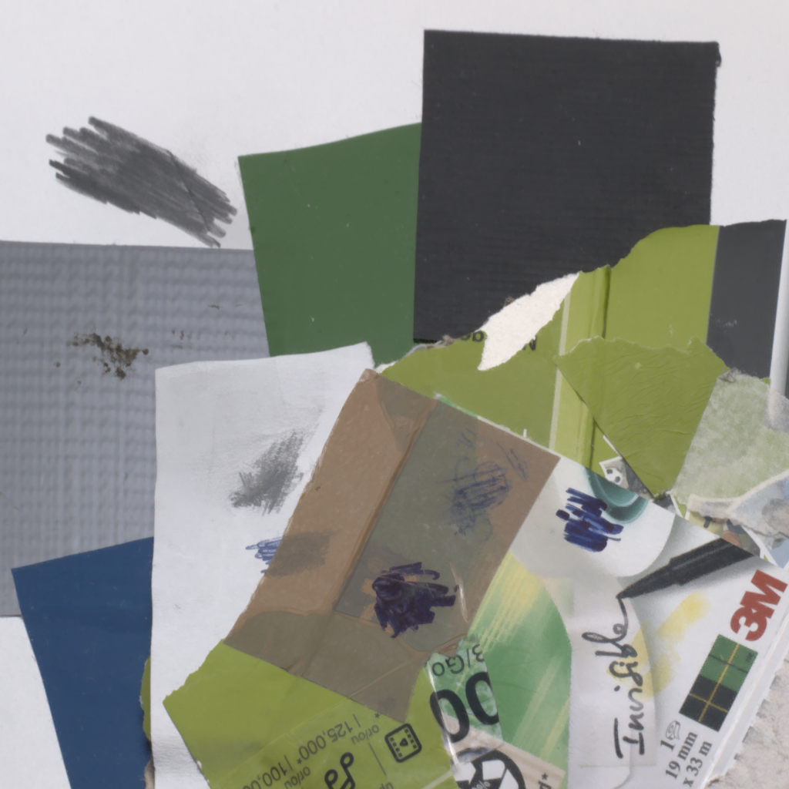
Diffuse albedo
Specular albedo
Glossiness
Kurtosis
Normals

Slide 49
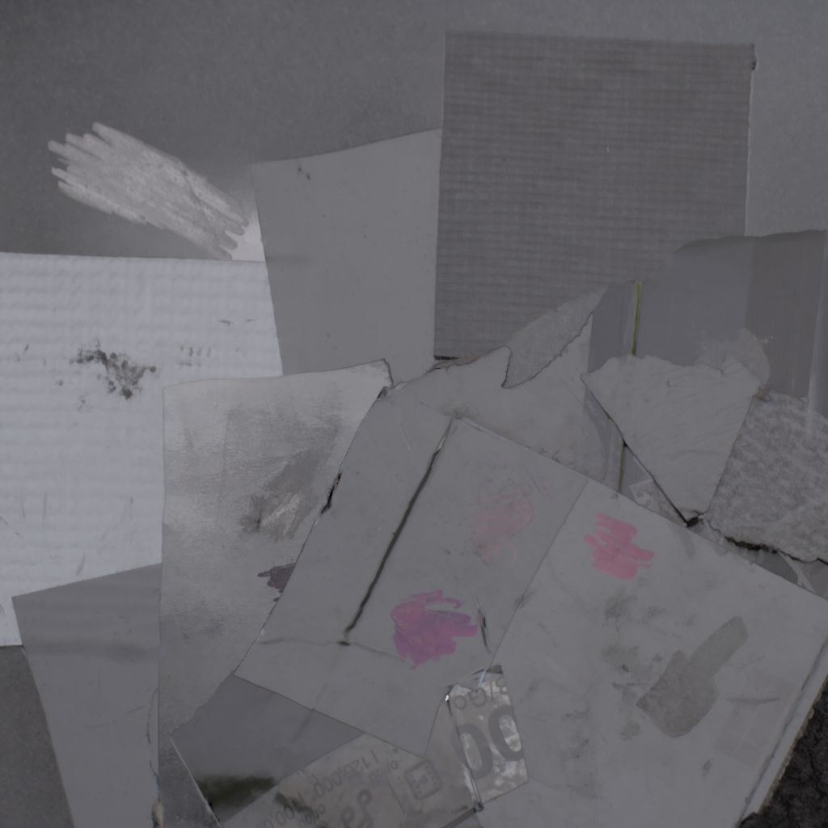
Diffuse albedo
Specular albedo
Glossiness
Kurtosis
Normals

Slide 50
Diffuse albedo
Specular albedo
Glossiness
Kurtosis
Normals

Slide 51
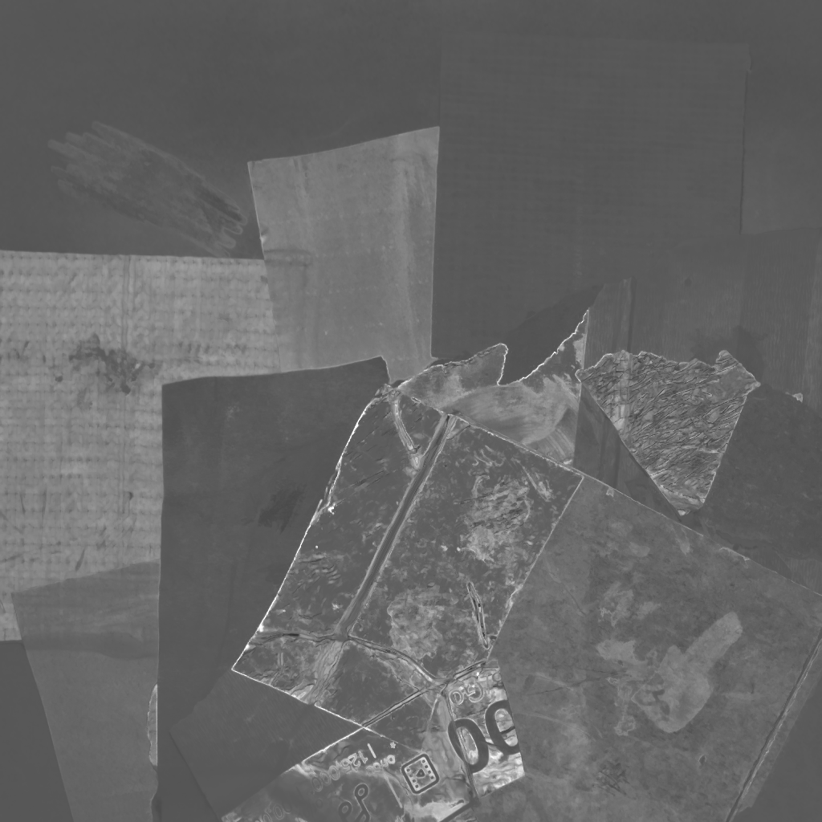
Diffuse albedo
Specular albedo
Glossiness
Kurtosis
Normals

Slide 52
Diffuse albedo
Specular albedo
Glossiness
Kurtosis
Normals

Slide 53
Discussion

Slide 54
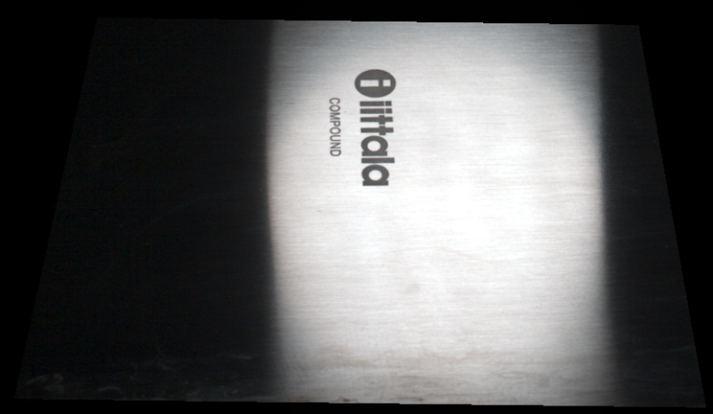
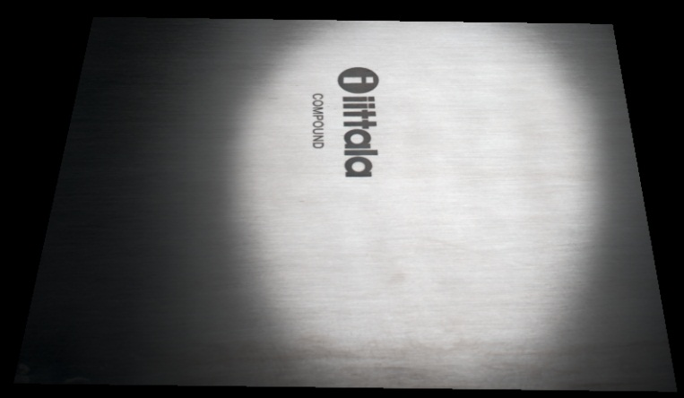
Limitations
Failure case: Brushed metal
Near-planar geometry
Diffuse + specular model
Simple heuristic for index of refraction, but some polarization effects baked in
Ground truth
Our result

Slide 55
Conclusion
Practical physical setup for capturing rich spatially varying surface appearance
Enabled by joint use of Fourier measurements and Gaussian approximations
Will release code and data

Slide 56
Thank you.

