Slide 2
Gradient-Domain Path Tracing
Markus Kettunen
Aalto University
Marco Manzi
University of Bern
Miika Aittala
Aalto University
Jaakko Lehtinen
Aalto University
NVIDIA
Frédo Durand
MIT CSAIL
Matthias Zwicker
University of Bern
Notes:
Thanks for the introduction.
This talk deals with physically based rendering, which means figuring out all the ways light can reach the camera after leaving the source.

Slide 3
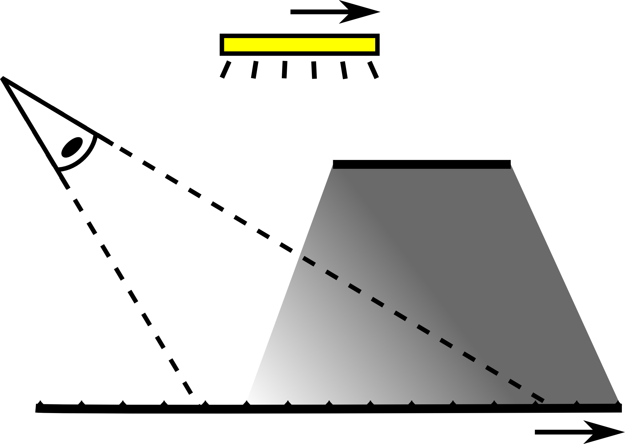
light
$$p$$
camera
occluder
receiving surface
$$x$$
Notes:
Let me illustrate this using a simple 2D example where we compute soft shadows on a plane from an area light source.
<c>Here I’m illustrating one potential path that reaches the camera, <c> but some of them don’t as they are occluded.
++ 0:23 / -17:37 ++

Slide 4
light
$$p$$
camera
throughput
occluder
receiving surface
$$x$$
Notes:
We call the amount of light carried by a path *its throughput*
<break>
++ 0:29 / -17:31 ++

Slide 5
Scene
light
$$p$$
camera
occluder
receiving surface
$$x$$
Notes:
So to get the color for a single pixel, we need to numerically integrate over all the paths that lead to the pixel and sum their throughputs.
++ 0:36 / -17:24 ++

Slide 6
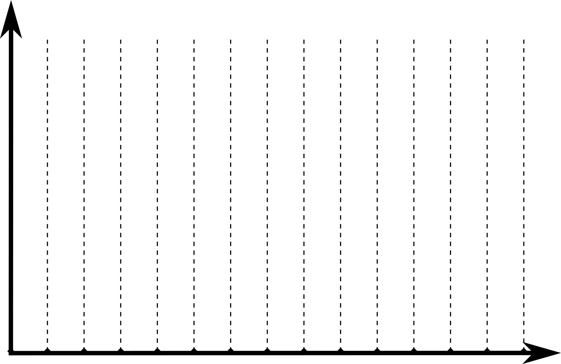
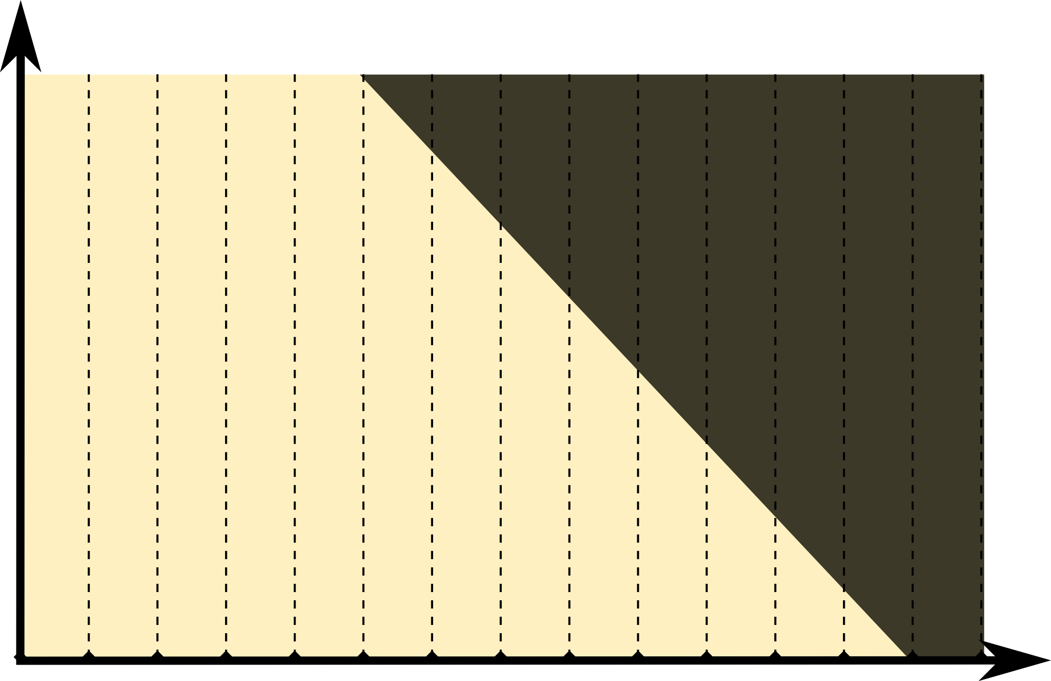
Scene
Path Space
$$p$$
$$p$$
$$p$$
$$x$$
$$x$$
$$x$$
Notes:
We represent each path as a point in a so-called *path space*. ... In this example, the path space only has two dimensions. <c>The first dimension x measures position on the receiving plane, and the other dimension p <c> is the origin on the light source.
<c>We now interpret x and p as <c>coordinates in a 2D plane, <c>and plot path throughput as a 2D function. As this path is occluded, its throughput is zero.
++ 1:03 / -16:57 ++

Slide 7
Scene
Path Space
$$p$$
∫
$$x$$
Notes:
Evaluating the pixel values then just means integrating down the columns of this 2D function.

Slide 8
Metropolis
Path Tracing
Gradient Metropolis
Notes:
The technique I’ll present in this talk is a so-called Monte Carlo method. These methods work by drawing random paths over path space. ... Let’s take a look at a couple of previous sampling algorithms in our 2D example.

Slide 9
$$p$$
[Kajiya1986]
Path Tracing
Gradient PT
+
$$x$$
Notes:
Standard path tracing simply draws a constant number of random paths uniformly in each pixel.
[wait]

Slide 10
Metropolis
Path Tracing
Gradient Metropolis
Gradient PT
Notes:
In contrast, <c>Metropolis Light Transport runs a Markov Chain in path space, [→→→] jumping from one path to the next

Slide 11
$$p$$
[Veach1997]
Metropolis Light Transport
no
samples
$$x$$
Notes:
... jumping from one path to the next. The process is designed so that bright paths are sampled more often and effort is thus concentrated in areas where contributions to the image are biggest.<c>
[wait]

Slide 12
Metropolis
Path Tracing
no
samples
Gradient Metropolis
Notes:
Recently, Lehtinen an colleagues developed a variation of Metropolis light transport<c> where they sample *image *gradients in addition to *pixel *values.

Slide 13
$$p$$
[Lehtinen2013]
Gradient-Domain MLT
no
samples
-
+
1 pixel
$$x$$
Notes:
Like Metropolis Light Transport, Gradient-domain MLT runs a Markov Chain and computes the *finite difference* of path throughput between neighboring pixels using pairs of paths.
<c>The pairs are constructed by shifting so-called base paths, in red<c>, into offset paths, in green, using a deterministic mapping, and then computing the difference in throughputs. ...<c>
The Markov Chain is modified to gravitate more towards regions where path throughput changes fast, as I’m showing here.<c> This makes intuitive sense, as simple, smooth areas in path space receive fewer samples than areas of fast change.
***** 2:51 / 15:09 *****

Slide 14
dx
Reconstruction
Screened Poisson Problem
dy
Sc
Throughput
Notes:
The outputs of this sampling process are two difference images, horizontal differences labeled dx on this slide, and vertical differences dy, <c>along with a noisy throughput image.
<c>They then solve a Screened Poisson problem <c>to find the image that best matches the sampled data.
This often provides a significant improvement over the standard approach, and we build on this same concept.

Slide 15
Metropolis
Path Tracing
no
samples
Gradient Metropolis
Gradient Path Tracing
no
samples
Notes:
Even though Metropolis methods are efficient for complex illumination, they suffer from unpredictable convergence. Path tracing, on the other hand, converges predictably and is easy to implement.
... The success of Gradient-Domain Metropolis <c>inspired us to investigate gradient sampling for regular path tracing. We show, that, maybe surprisingly, we can benefit from gradient sampling also in standard path tracing, even without changing sample distributions.<c>
... ... ...
A gradient domain path tracer is actually rather easy to implement, and I will next describe the main components of the algorithm.
***** 3:44 / -14:16 *****

Slide 16
Notes:
We drive gradient domain path tracing by a standard path tracer <c>that shoots a number of paths through each pixel.

Slide 17
Base Path
Base Path
Base Path
Base Path
Notes:
We call these paths *base paths*. [wait]

Slide 18
Offset Path
Offset Path
Offset Path
Offset Path
Notes:
To obtain the finite difference gradients, <c>we *shift each *base path to all four neighboring pixels.<c> We call these paths <c>*offset paths*.

Slide 19
Notes:
Sampling a base path and shifting it to the four neighbors gives us a <c>throughput estimate<c> and four gradient estimates: <c>left, <c>top, <c>right and <c>bottom. These are accumulated into their respective buffers.
... Let’s now have a look at how to actually construct the offset paths.
***** 4:22 / -13:38 *****

Slide 20
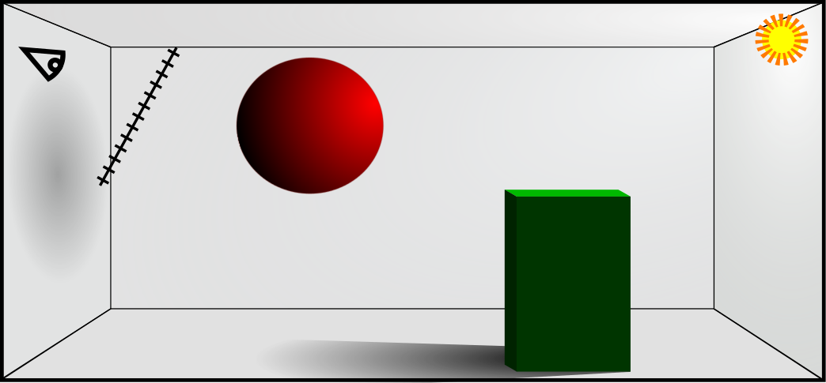
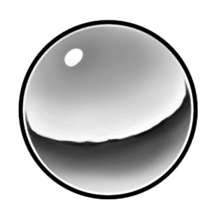
Base Path
Offset Path
Light
Mirror
Notes:
Let’s look at a simple scene where we have shot <c>this base path using a standard path tracer.
We then generate an offset path, <c>shown in green. It needs to go exactly one pixel apart, <c>and this determines the first leg of the offset path.
... As we discuss in the paper, the shift is mathematically a change of integration variables, so we have a *lot of possibilities on how to continue. ... Intuitively, we want to construct offset paths that are as similar as possible to their base paths. This leads to small throughput differences which reduces noise significantly. I will give a more detailed theoretical argument later in the talk.

Slide 21
Vertex classification
Base Path
Offset Path
Non-Specular
Light
Mirror
Specular
Non-Specular
Notes:
Before we go on, we classify all path vertices as either <c>specular, or <c>non-specular, based on a threshold on the roughness of the BRDF.

Slide 22
Case: Reconnect
Base Path
Offset Path
Light
Mirror
Non-Specular
Non-Specular
Non-Specular
Notes:
We distinguish between two cases: <c>If both the current base and offset vertices, shown in blue here, are non-specular<c>, and the <c>next vertex of the base path, shown in yellow, <c>is also non-specular, then we reconnect the offset path to the base path<c>. After this, we let the offset path follow the base path until we reach the light.<c>
...This leads to paths that are as similar as possible. As a result, the throughput difference will be small, because the vertices where the paths differ are non-specular.
... However, for highly glossy materials, which we classify as specular, this strategy may not work well because the incoming and outgoing directions change when we reconnect.

Slide 23
Case: Continue
Half-vector
Base Path
Ideal Reflection
Offset Path
Light
Mirror
Notes:
We address this issue by continuing to trace the offset path if we hit a vertex classified as specular.
... Assume that we have shot <c>this base path whose first vertex is at a specular surface. <c>In this case, the offset path should have a similar BRDF value at the corresponding vertex.
We achieve this by <c>copying the half-vector in<c>local tangent coordinates, <c>and this determines the direction of the next path segment.

Slide 24
Case: Continue
Half-vector
Base Path
Ideal Reflection
Offset Path
Light
Mirror
Non-Specular
Non-Specular
Non-Specular
Notes:
We continue by duplicating local half-vectors until we encounter <c>two <c>consecutive non-specular vertices in the base path, *and the <c>offset path is also sitting at a non-specular vertex. ... In this configuration we can <c>safely reconnect to the base path, as mentioned before.<c>
***** 6:48 / -11:12 *****

Slide 25
That’s it!
Simple modification of
standard path tracer
Several third-party implementations
Local shift, no manifold perturbation
25
Notes:
***(Make it clear that this is a transition)***
Now, this is almost all you need to know to implement your own gradient-domain path tracer. Also, we are aware of several external researchers who have already reproduced the algorithm.
In particular, our shifting strategy is local and does not require sophisticated machinery such as manifold perturbation, which was needed as a core component in gradient domain Metropolis.
Let’s see the first example of how this works.

Slide 26
Notes:
Sponza is a simple diffuse scene, lit from above by a large area light.

Slide 27
Path Tracing, 8 spp
Notes:
Rendering with the path tracer in Mitsuba, with 8 samples per pixel, we get heavy noise.

Slide 28
dx
throughput
dy
Notes:
In equal-time, the gradient-domain sampler outputs the <c>horizontal differences, the <c>vertical differences, <c>and the throughput image, and reconstructs →→→ this result.

Slide 29
Our Result, Equal Time
Notes:
... this result.

Slide 30
Path Tracing, 8 spp
Ours, Equal Time
Notes:
Our result lacks most of the high frequency noise, and is much cleaner overall.

Slide 31
Path Tracing, 128 spp
Ours, Equal Time
Notes:
With sixteen times more samples, the path traced image is still very noisy, but *our result is essentially ready.

Slide 32
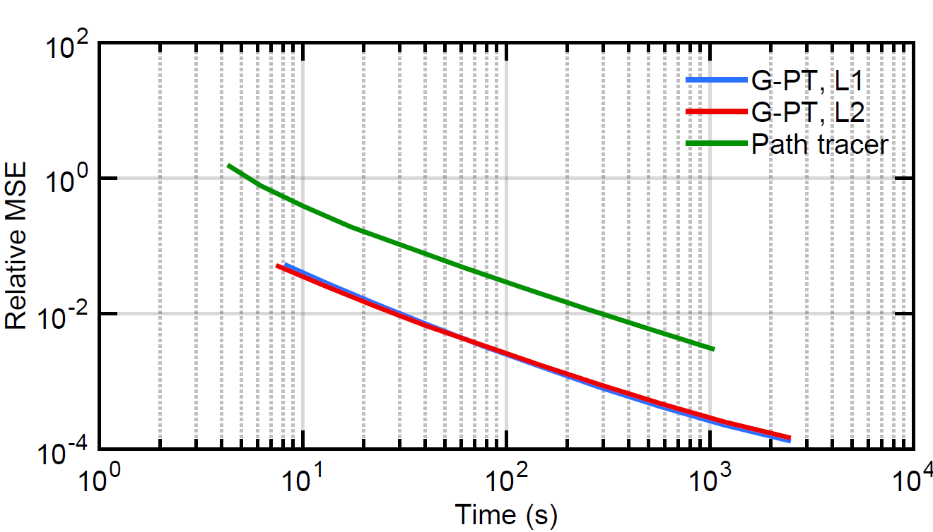
Error vs. Time (Sponza)
12x
Notes:
Plotting relative mean square error against time, we’re almost twelve times faster.
<pause>
... When we saw how well this works, we were really quite surprised.
***** 8:14 / 9:46 *****

Slide 33
Analysis
Standard Monte Carlo
Notes:
(Make it rhethorically clear that you are transitioning)
...and for that reason, we’ll now shed some light on why this actually works by looking at the entire sampling and reconstruction process in the frequency domain. ... Let’s begin by reminding ourselves of what happens in standard Monte Carlo random sampling.

Slide 34
Path throughput
$$f$$
$$p$$
$$x$$
Notes:
For this, I will go back to a 2D setup like in the beginning, with the image along the x-axis, and a path dimension along the p-axis. F is the path throughput function. We will obtain the final image by integrating over p.

Slide 35
Path throughput
$$f$$
Fourier transform
$$\text{ℱ}\{f\}$$
$$p$$
$$ω_{p}$$
$$x$$
$$ω_{x}$$
Notes:
On the right, I show <c>the power spectrum of the throughput function.

Slide 36
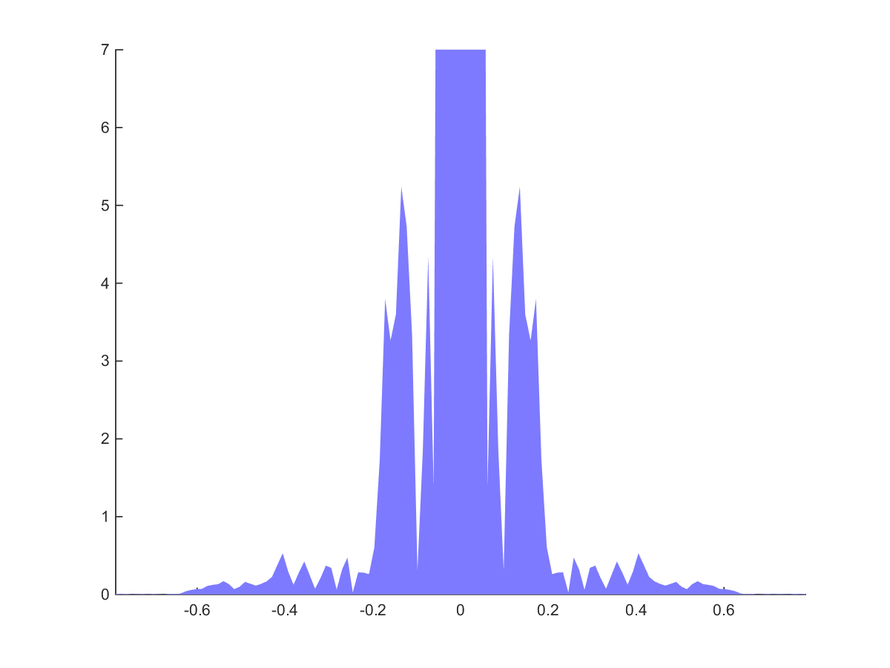
$$f$$
$$\text{ℱ}\{f\}$$
Slice $(ω_{p}=0)$
Path throughput
Fourier transform
$$p$$
$$ω_{p}$$
$$ω_{x}$$
$$x$$
$$ω_{x}$$
Notes:
To get a better view, let’s <c>concentrate on this horizontal slice:<c>

Slide 37
Slice $(ω_{p}=0)$
Fourier transform
$$\text{ℱ}\{f\}$$
$$ω_{p}$$
$$|f{\left(ω_{x}\right)|}^{2}\sim \frac{1}{{|ω_{x}|}^{2}}$$
$$ω_{x}$$
$$ω_{x}$$
Notes:
We see that <c>the shape resembles one over frequency squared. This is because the final image, just as the throughput function overall, has discontinuities and resembles a natural image.
... The fact that the energy is heavily concentrated near the low frequencies is going to be crucial for us later on.

Slide 38
$$f$$
$$\text{ℱ}\{f\}$$
Slice $(ω_{p}=0)$
Fourier transform
$$p$$
$$ω_{p}$$
$$|f{\left(ω_{x}\right)|}^{2}\sim \frac{1}{{|ω_{x}|}^{2}}$$
$$ω_{x}$$
$$x$$
$$ω_{x}$$
Notes:
Let us now analyze Monte Carlo sampling.
In the primal domain, random sampling multiplies the signal by a forest of random Dirac impulses.

Slide 39
$$⋅f$$
$$\text{ℱ}\{f\}$$
$$f$$
$$p$$
$$ω_{p}$$
$$x$$
$$ω_{x}$$
Notes:
Each impulse corresponds to the location of one sample.
... So what does this look like in the frequency domain?

Slide 40
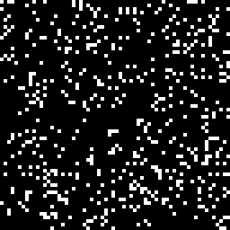
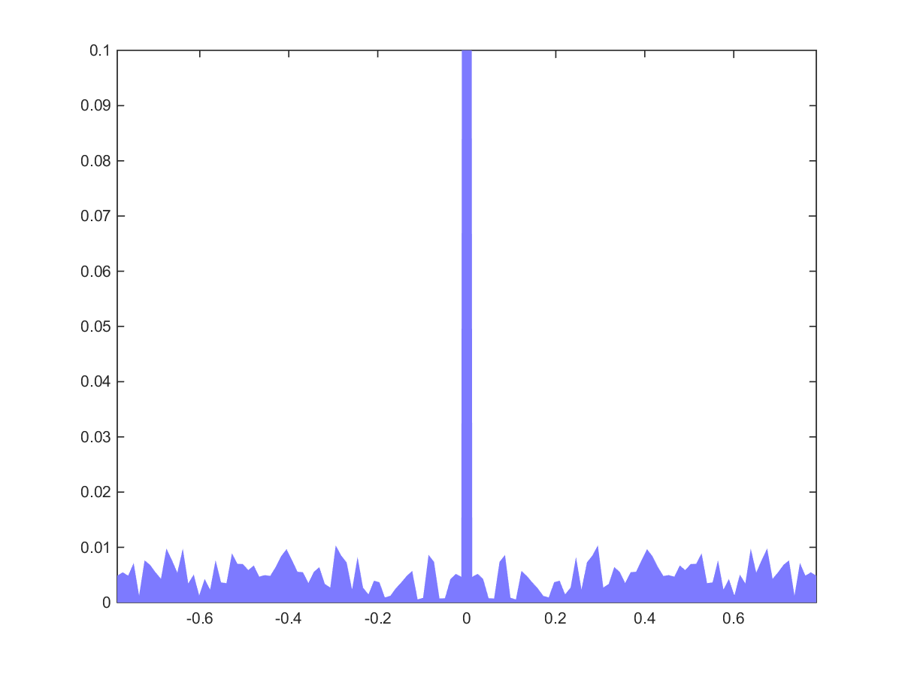
[Dippé&Wold1985]
$$⋅f$$
$$\text{ℱ}\{f\}$$
$$p$$
$$ω_{p}$$
$$p$$
$$ω_{p}$$
$$ℱ =$$
$$ω_{x}$$
$$x$$
$$ω_{x}$$
$$x$$
$$ω_{x}$$
Notes:
<c>This is the Fourier transform of the random samples. It has a strong peak at the DC, and uniform random noise everywhere else. The slice on the right shows this more clearly.
<c>...As we know, multiplication in the primal corresponds to a convolution in the frequency domain.

Slide 41
$$ℱ\{ \}∗\text{ℱ}\{f\}$$
$$⋅f$$
$$\text{ℱ}\{f\}$$
$$p$$
$$ω_{p}$$
$$x$$
$$ω_{x}$$
Notes:
When we do this, we see that this spreads the energy uniformly over the path space as white noise.
... Because we are dealing with random sampling, however, we are interested in the expected error, →→→ and it is well known that

Slide 42
$$⋅f$$
$$ℱ\{ \}∗\text{ℱ}\{f\}$$
$$p$$
$$ω_{p}$$
Average Case
$$x$$
$$ω_{x}$$
Notes:
..., and it is well known that the magnitude of the noise is proportional to the total energy of the signal. This shows up as the gray background in the right.

Slide 43
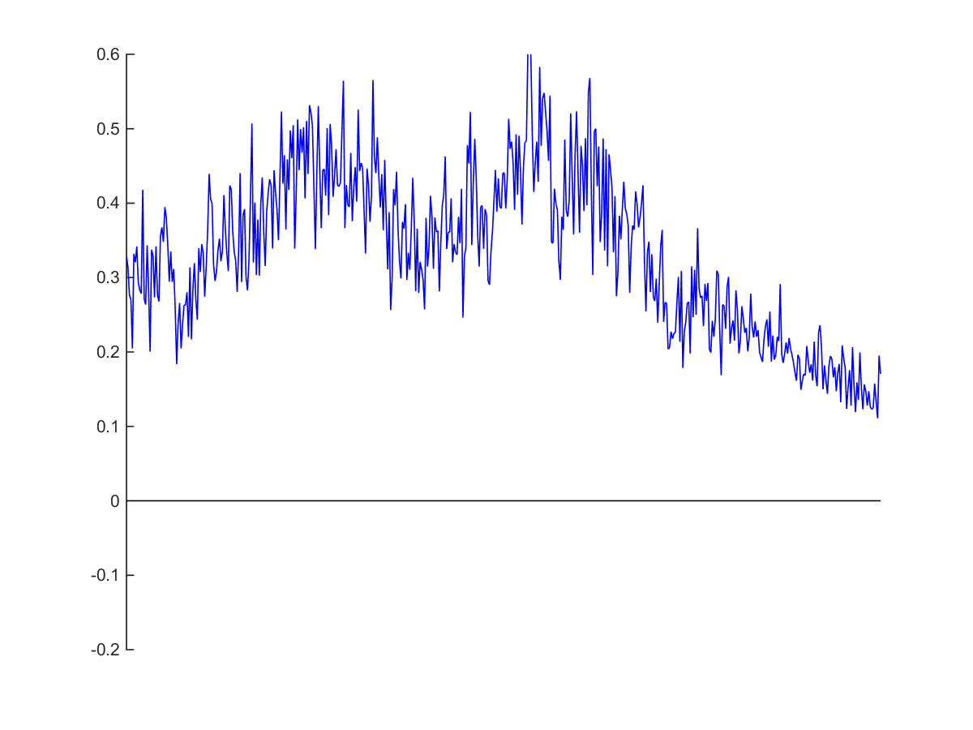
$$\int{ ⋅f dp}$$
$$⋅f$$
$$ℱ\{ \}∗\text{ℱ}\{f\}$$
$$p$$
$$ω_{p}$$
$$x$$
Average Case
$$x$$
$$ω_{x}$$
Notes:
To get the final image, we accumulate the random samples in each pixel. We end up with an estimate of the image with some amount of sampling noise.<c>

Slide 44
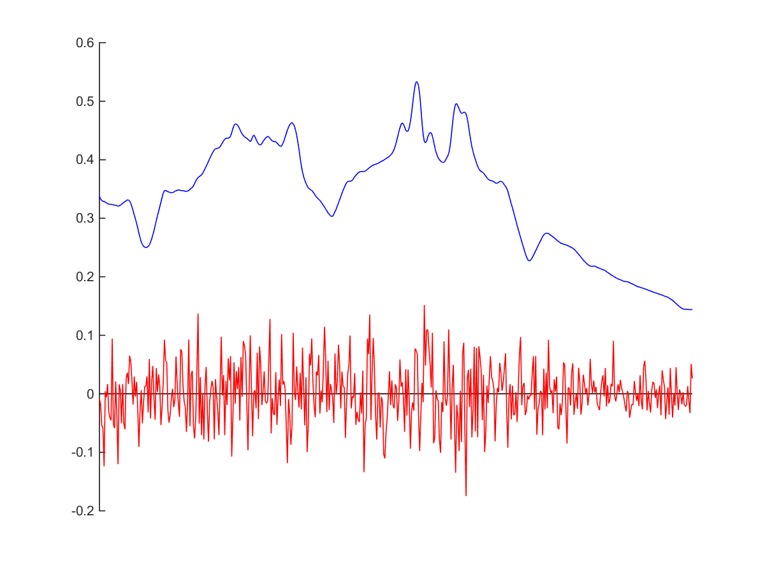
$$\int{ ⋅f dp}$$
$$ℱ\{ \}∗\text{ℱ}\{f\}$$
$$ω_{p}$$
Signal
Noise
$$x$$
$$ω_{x}$$
Notes:
This is just white noise with ... →→→ standard deviation proportional to the energy of the signal.

Slide 45
$$\int{ ⋅f dp}$$
$$ℱ\{ \}∗\text{ℱ}\{f\}$$
$$ω_{p}$$
Signal
Noise
$$σ \sim {\left\|f\right\|}_{2}$$
$$x$$
$$x$$
$$ω_{x}$$
Notes:
standard deviation proportional to the energy of the signal.

Slide 46
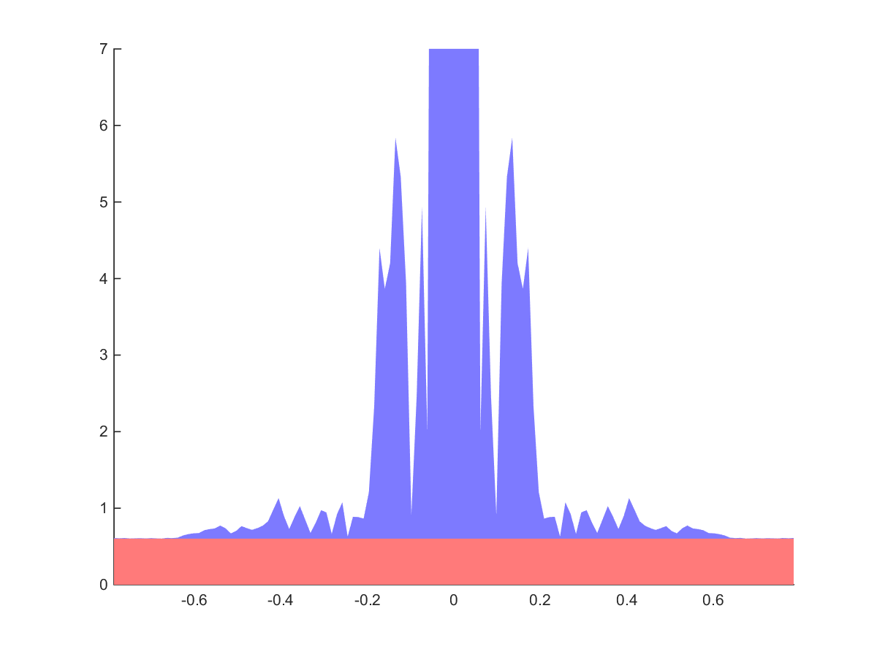
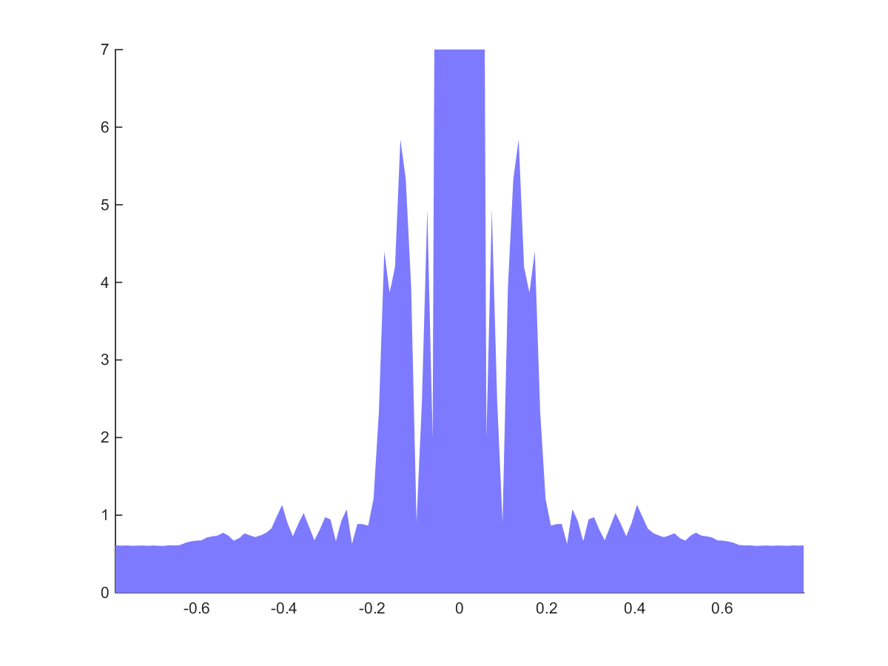
$$\int{ ⋅f dp}$$
$$ℱ\{ \}∗\text{ℱ}\left\{f\right\}{\left.​ \right|}_{ω_{p}=0}$$
Signal
Signal
Noise
Noise
$$σ \sim {\left\|f\right\|}_{2}$$
$$x$$
$$x$$
$$ω_{x}$$
Notes:
The noise shows up in the frequency domain as the red box on the right, which is a slice through the gray background from before.
... Here, we have derived the well known result that sampling noise is white and its magnitude is proportional to the signal’s energy.
***** 11:02 / -6:58 *****

Slide 47
Analysis
Standard Monte Carlo
Gradient Sampling
Notes:
With that in the bag,
<c>let’s see what happens when we sample gradients instead.

Slide 48
$$∗f$$
$$\text{ℱ}\{f\}$$
$$f$$
$$p$$
$$ω_{p}$$
+
-
+
-
+
-
+
-
+
-
$$x$$
$$ω_{x}$$
Notes:
Taking finite differences <c> corresponds to a convolution<c> with a kernel with a positive and a negative Dirac.
... As we know, convolution corresponds to multiplying the spectra.

Slide 49
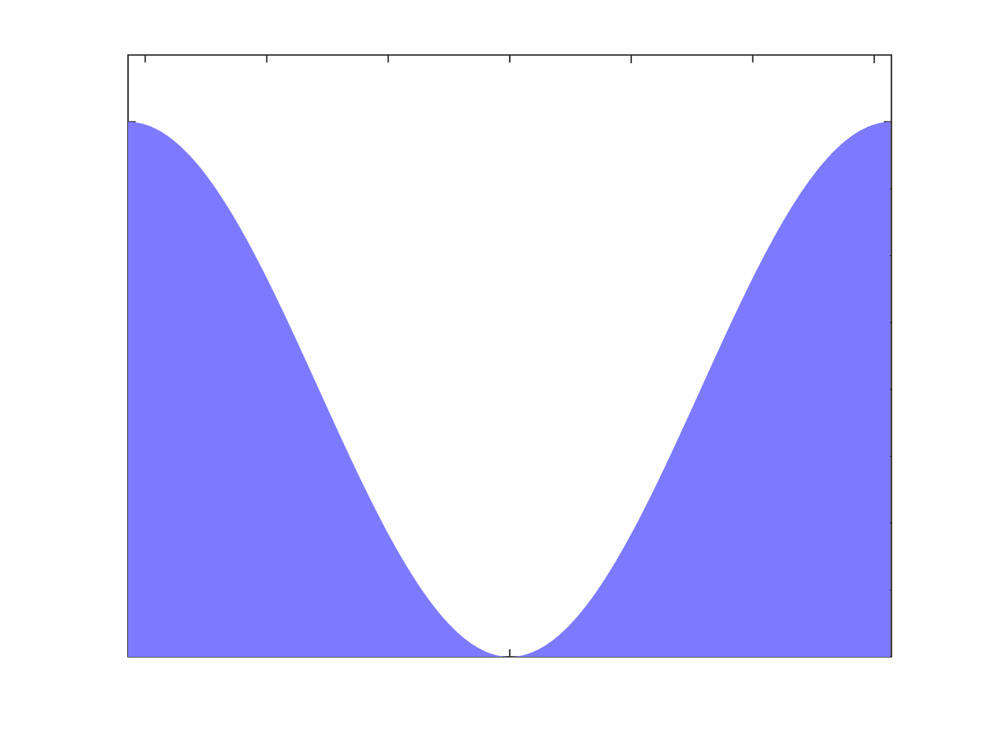
$$\text{ℱ}\{f\}$$
$$∗f$$
$$\text{ℱ}\{ \}⋅\text{ℱ}\{f\}$$
$$ω_{p}$$
$$p$$
$$p$$
$$ω_{p}$$
$$ℱ →$$
-
+
$$x$$
$$ω_{x}$$
$$ω_{x}$$
$$x$$
$$ω_{x}$$
Notes:
...The power spectrum of the finite difference kernel is a squared sine, with the period of the pixel pitch...<c>
This then multiplies the power spectrum of the signal: <c>
To see clearly what this does, ... →→→ let us again concentrate on this slice

Slide 50
$$∗f$$
$$\text{ℱ}\{ \}⋅\text{ℱ}\{f\}$$
Slice $(ω_{p}=0)$
$$p$$
$$ω_{p}$$
$$x$$
$$ω_{x}$$
$$ω_{x}$$
Notes:
let us again concentrate on this slice<c>.
... *This* is where things get interesting.

Slide 51
Slice $(ω_{p}=0)$
$$\text{ℱ}\{ \}⋅\text{ℱ}\{f\}$$
$$ω_{p}$$
$${\left|\text{ℱ}\left\{ \right\}\right|}^{2}$$
$$ω_{x}$$
$$ω_{x}$$
Notes:
The squared sine, in red, has low values near the origin where most of the energy of the throughput signal is. .. Now, clearly, when we multiply these, most of that energy will go away!

Slide 52
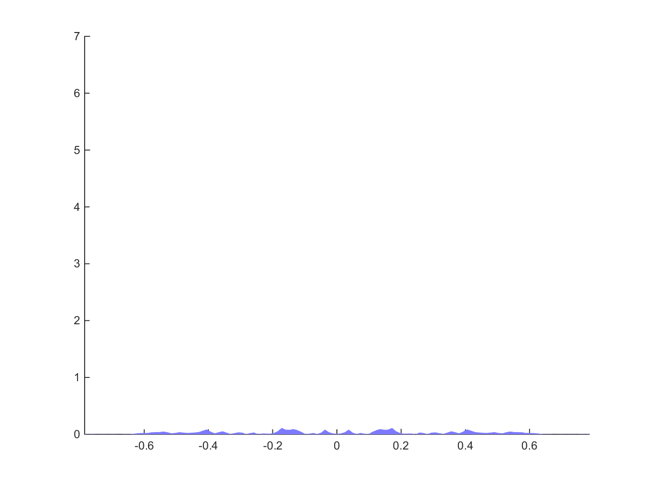
$$\text{Slice}\text{:} \text{ℱ}\{ \}⋅\text{ℱ}\{f\}$$
$$\text{ℱ}\{ \}⋅\text{ℱ}\{f\}$$
Slice $(ω_{p}=0)$
$$ω_{p}$$
Most energy gone!
$${\left|\text{ℱ}\left\{ \right\}\right|}^{2}$$
$$ω_{x}$$
$$ω_{x}$$
Notes:
We’re left with the gradient signal whose magnitude is much lower than the original signal.
Crucially, as the sampling noise is proportional to the energy, this means sampled gradients will have much less noise than the sampled signal itself.
***** 12:12 / -5:48 *****

Slide 53
Analysis
Standard Monte Carlo
Gradient Sampling
Reconstruction
Notes:
However, we’re not really interested in the gradients, but the image we reconstruct using them. <c>So let’s go on and see what happens when we do Poisson reconstruction.

Slide 54
Sampled Gradients
Signal
Noise
$$ω_{x}$$
Notes:
[break]
Here is the spectrum of the sampled gradients again. Let’s zoom in so that we see something.

Slide 55
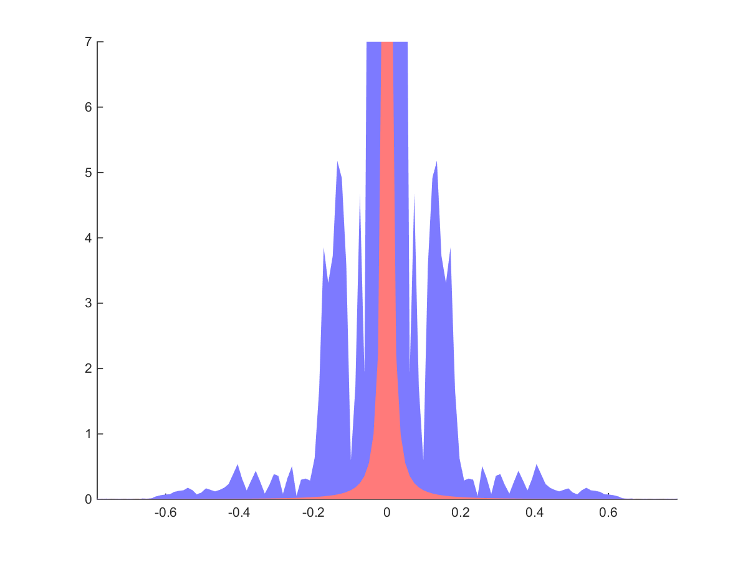
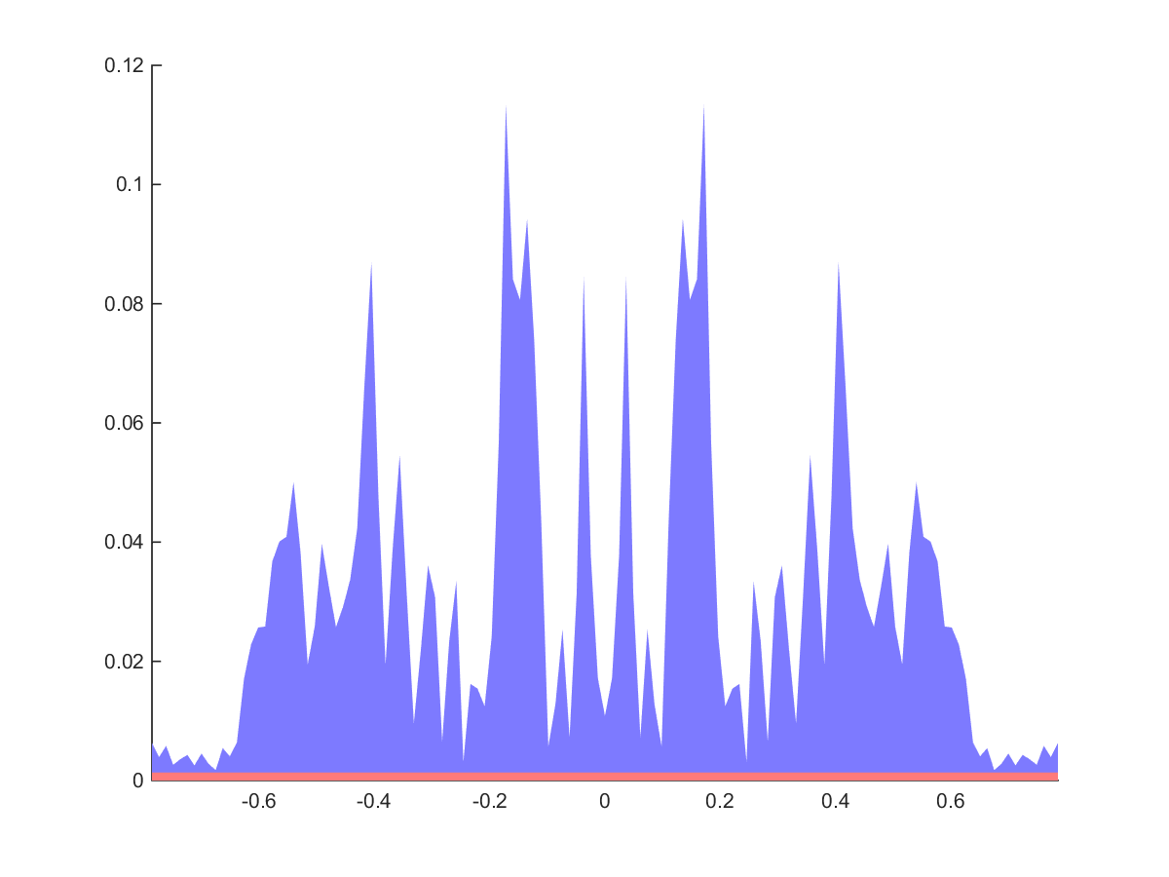
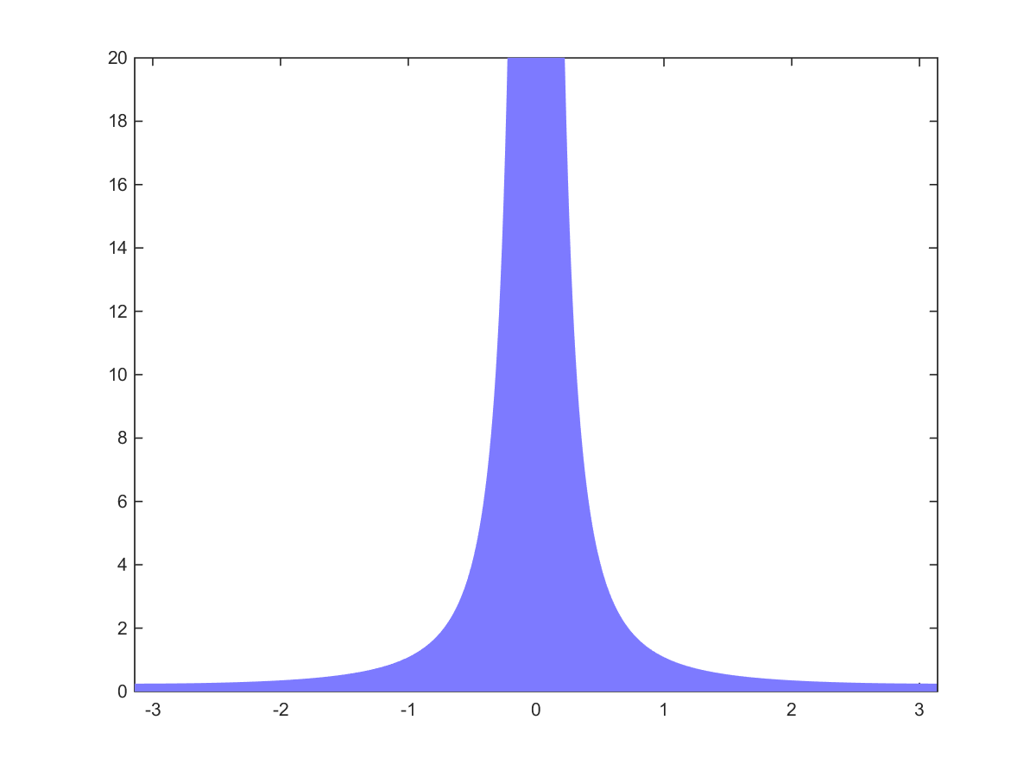
$$\frac{1}{ }$$
Integrated Gradients
Sampled Gradients
Signal
Noise
$$=$$
$$ω_{x}$$
$$ω_{x}$$
$$ω_{x}$$
Notes:
<c> To reconstruct the final image, we invert the gradient operator, by dividing by its power spectrum, the squared sine. ...<c>
<c>When we do this <c>, the noise in the low frequencies blows up completely, which makes intuitive sense, as the gradients do not contain information about the DC.
However, the <c>high frequencies are excellent, with much lower error than before. [wait]<c>
... Compare this to standard sampling ... →→→ on the right

Slide 56
Integrated Gradients
Standard Monte Carlo
Signal
Signal
Noise
Noise
$$ω_{x}$$
$$ω_{x}$$
Notes:
... on the right. <c> Its level of noise is much worse in the high frequencies, whereas the low frequencies are represented better.
... Given this, it’s not a stretch to figure out that we should take the high frequencies from the integrated gradients, and the low frequencies from standard sampling.

Slide 57
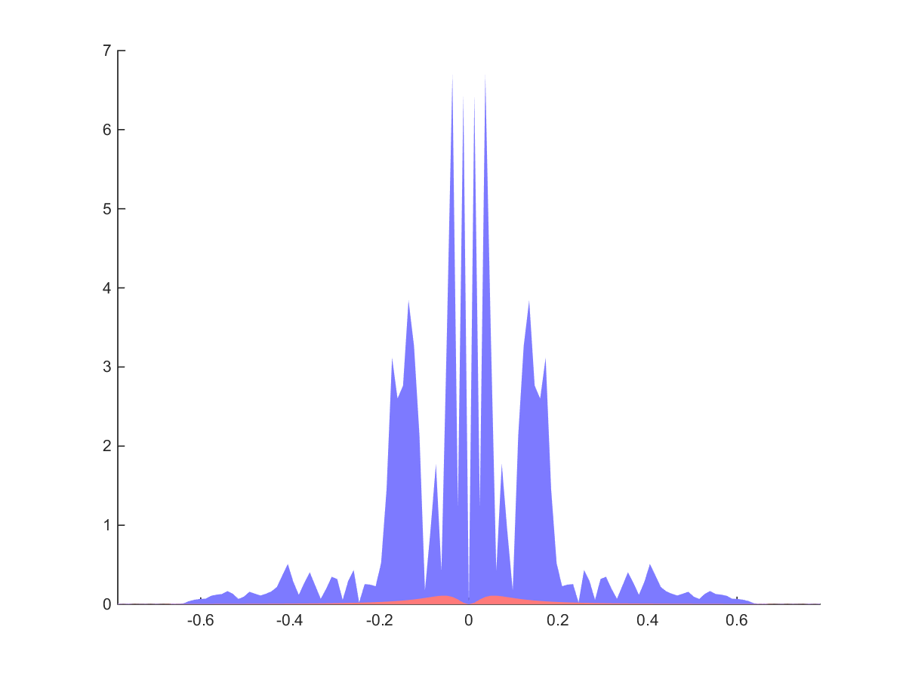
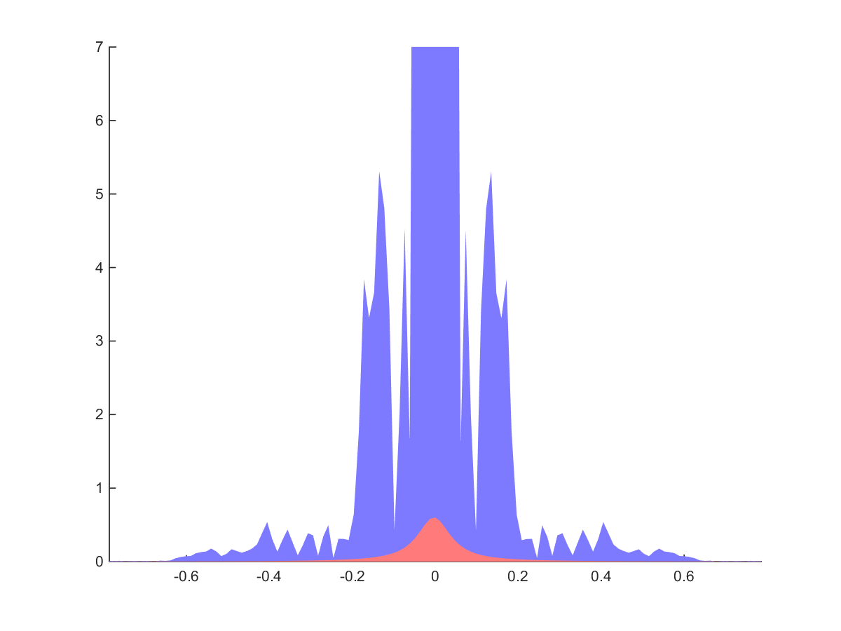
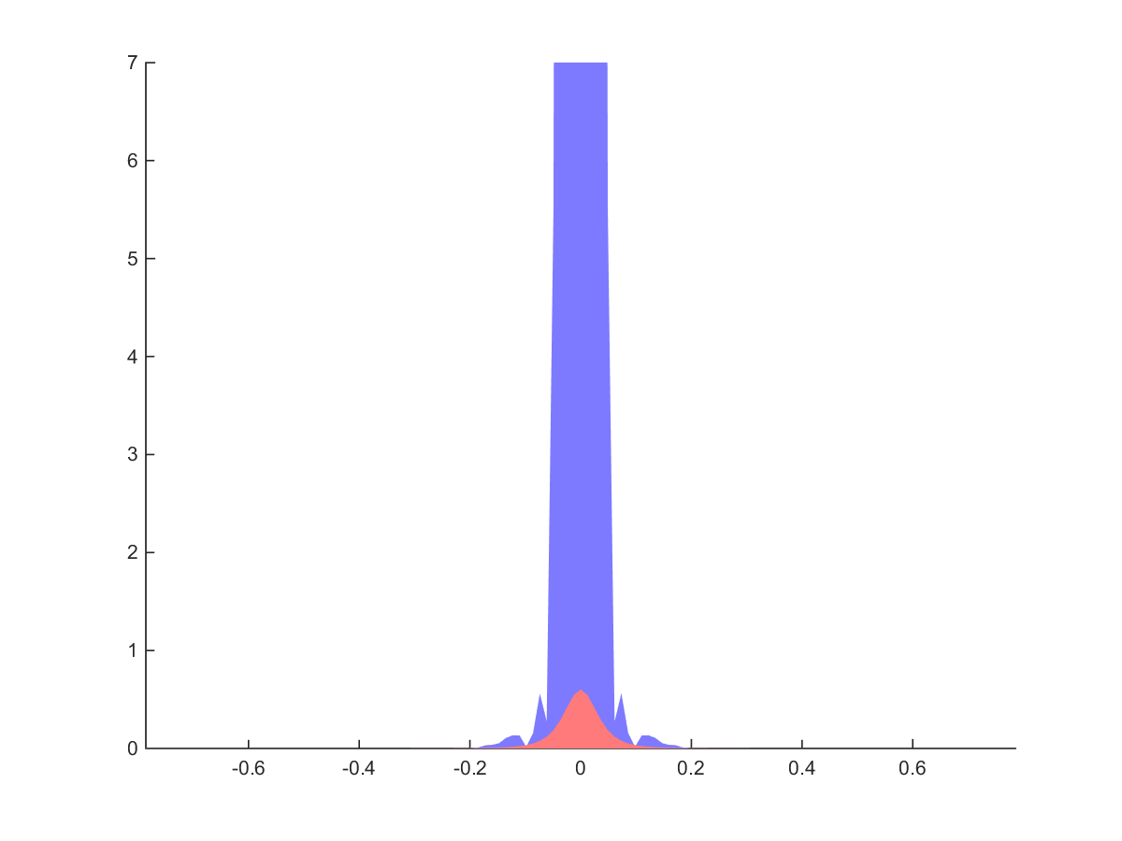
Integrated Gradients
High pass
Reconstruction
$$ω_{x}$$
$$ω_{x}$$
Standard Monte Carlo
Low pass
$$ω_{x}$$
$$ω_{x}$$
$$ω_{x}$$
Notes:
This simply means applying a high pass filter to the gradient reconstruction, <c> and a low pass filter to the regular sampling.<c>
<c>Summing these <c>gives the final reconstruction, which has the best of both worlds, and has a much lower level of overall noise than either of the inputs alone.

Slide 58
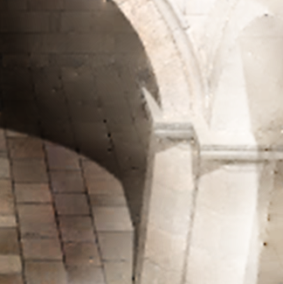
Integrated Gradients
High pass
Reconstruction
Standard Monte Carlo
Low pass
Notes:
Concretely, it looks like this.
The standard sampling has lots of noise, <c>whereas the gradient reconstruction has good detail but the low frequencies are badly wrong.
<c>High-passing gets rid of the offending low frequencies above, <c> and low-passing gets rid of the noise below.
<c>Their sum is much nicer than either alone.<c>
[wait]

Slide 59
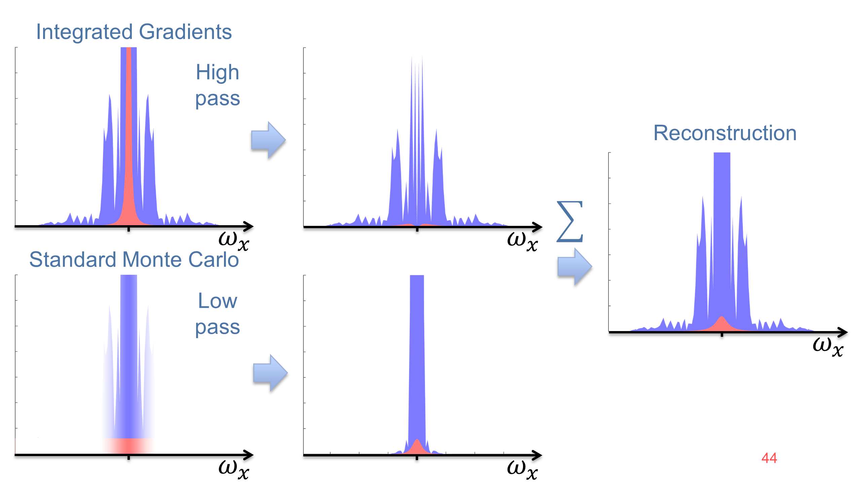
Primal
Fourier
Sc
$$\underset{X}{arg min}$$
$${\left\|∇X−\left[\begin{matrix}dx \\ dy\end{matrix}\right]\right\|}_{2}^{2}+α^{2}{\left\|X−f\right\|}_{2}^{2}$$
Notes:
As an aside, it turns out solving the Screened Poisson problem in the primal domain does exactly what I just described.

Slide 60
Analysis Conclusions
Benefits when gradient has low energy in comparison to actual signal
Higher-energy gradients will perform worse
E.g. complex geometry at subpixel scales
Often a net win!
Notes:
So what does this analysis tell us?
To get a benefit out of gradient sampling, the throughput function needs to have most of its energy at the low frequencies. In the paper we show that it’s precisely the ratio of the energies of the signal and its gradient that determines efficiency. The less energy in the gradients, the better.
This tells us that conversely high-energy gradients will perform worse. This happens, for instance, if the image contains really complex geometry like grass or something like that at the subpixel level. But a lot of the time, when your scene is modeled in reasonable detail, gradients do provide a benefit.
***** 15:28 / -2:32 *****

Slide 61
Results
Notes:
[pause]
…, …, So, let’s look at results.

Slide 62
Path Tracing, 8 spp
Ours, Equal Time
Notes:
Sponza you already saw; in this easy scene the method really shines.

Slide 63
Notes:
The bathroom scene is hard for path tracing, as it’s illuminated from behind a window, and this makes shadow rays useless. It also has lots of glossy materials and a mirror.

Slide 64
Path tracing, 512 spp
Notes:
Five hundred samples per pixel are not enough to get a converged image with standard path tracing.

Slide 65
Ours, Equal Time
Notes:
Despite the somewhat complicated light transport, we manage to kill most of the high frequency noise.

Slide 66
Path Tracing, 512 spp
Ours, Equal Time
Notes:
Zooming in, we see that we’re doing much better than path tracing, <c>although the level of noise is non-uniform as we can see in this highly curved glossy object. We discuss this more in the paper.

Slide 67
Path Tracing, 64 spp
Ours, Equal Time
Notes:
Still, with rendering time that’s not enough for standard path tracing to even produce an image, we get something recognizable out, which I think is pretty cool.

Slide 68
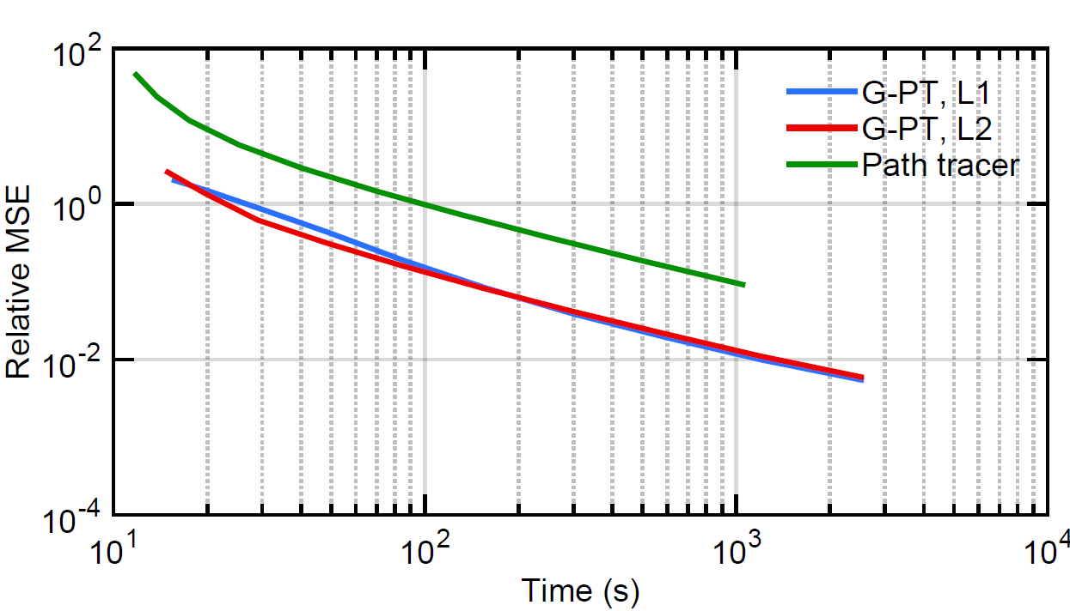
Error vs. Time (Bathroom)
7x
Notes:
In this scene, we are around seven times faster than standard path tracing.

Slide 69
Notes:
The Door scene is designed to be hard for path tracing since all light comes from another room through the slightly opened door.

Slide 70
5x
Path Tracing, 4096 spp
Ours, Equal Time
Notes:
Here too we produce a significantly better image in equal time, despite the complexity of the light transport.
<c>The speedup is roughly a factor of five.

Slide 71
Notes:
This Kitchen scene is very challenging for the gradient path tracer with its glossy surfaces lit by a small and hard to reach light source.

Slide 72
5x
Path Tracing, 512 spp
Ours, Equal Time
Notes:
Still, we again outperform standard path tracing <c>by a factor of five.
[wait]
***** 16:37 / -1:23 *****

Slide 73
Gradient MLT, 512 spp
Ours, 512 spp
Notes:
Finally, let’s contrast our method to Gradient-Domain Metropolis. ... *Standard Metropolis generally does better than *standard path tracing when light transport is extremely challenging. However, its convergence is unpredictable and non-uniform as seen in the splotchiness in the error image on the left. ... *While Gradient Metropolis generally improves the situation, it unfortunately inherits the convergence issues.
In contrast, well-implemented *standard path tracing beats MLT in easy transport situations, and converges predictably. We are happy to report that these good properties carry over to *gradient path tracing.

Slide 74
conclusion
Notes:
To conclude,
***** 17:27 / -0:33 *****

Slide 75
Conclusion
Introduced gradient-domain path tracing
5x to 12x faster than standard path tracing
Unbiased with L2 Poisson reconstruction
First end-to-end frequency-domain analysis on gradient-domain rendering
75
Notes:
... we introduced gradient-domain path tracing, a relatively simple modification of standard path tracing that yields a significant benefit in image quality.
To see the reasons for its initially surprising efficiency, we also presented the first end-to-end frequency-domain analysis about gradient-domain rendering.

Slide 76
Future Work
Adaptive sampling
Other gradient-domain methods!
76
Notes:
As for future work, we’d like to dynamically analyze the properties of the sampled signals to adaptively place more samples where they matter the most.
Also, we believe that many common methods could be improved by introducing gradient-domain versions of them. Gradient-domain photon mapping? Gradient-domain virtual point lights? These all sound exciting!
***** 18:00 / ---- *****

Slide 77
Thank you!
Notes:
Thank you for your attention.

Slide 78
Notes:
Now that we know how to shift paths, let’s take another look at the previously described sampling process.<c>
... A pair of paths that form<c> a gradient sample can be sampled from two directions:
From the left like we just did, <c> ... or <c>from the right.
Since the path pair can be sampled from two directions, we can apply multiple importance sampling between them. See the paper for details.

Slide 79
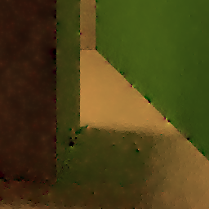
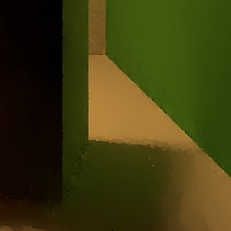
L1 with MIS
With MIS
Without MIS
Notes:
This <c>gets rid of many artifacts present in earlier gradient-domain rendering methods.
... To get rid of the rest of the artifacts, like Lehtinen and colleagues, we recommend using the slightly biased L1 reconstruction.<c>
[wait][wait][wait]

